Slide 1
EMG Signal Activation Pattern Recognition
Julie Werner
Mike Peña
Jason Yeung

Slide 2
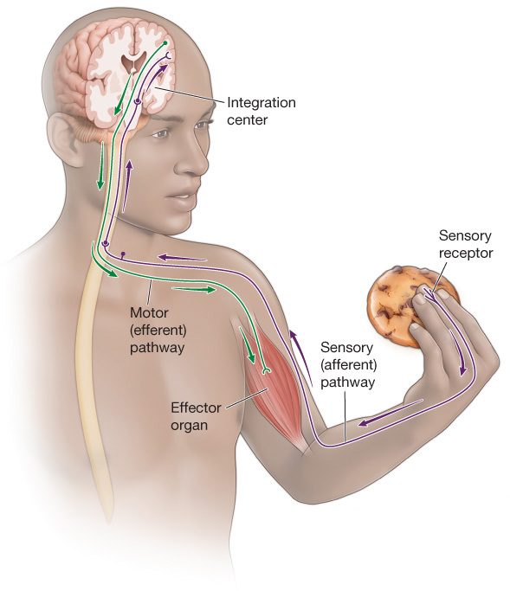
Background
Electromyogram (EMG) is used to observe and record the physiological function of skeletal muscle, and by extension, the function of the nervous system
EMG signals reflect the activity of muscle fibers (muscle cells)
Single-unit recording
Surface recording
Muscle activity occurs differentially over time
Time series
How can we quantify and analyze muscle function?
Stern RM, Ray WJ, Quigley KS (2001)
Notes:
Single-unit recording uses a very small needle inserted into the muscle. It is considered more invasive, and thus requires additional permissions to use this method for human-subjects research from the Institutional Review Board (IRB), which is the ethics panel. If permission can be obtained, this is a more direct method of recording the function of a muscle cell, as the recording is limited to the single cell and can be modeled according to the known physiology of muscle tissue.
Surface EMG recording requires IRB approval (like any human-subjects research), but is considered “Minimal Risk,” so there is much less scrutiny involved. It is easier to access and does not involve inserting a needle into muscle. However, surface EMG collects electrical signal from several muscle cells at a time.

Slide 3
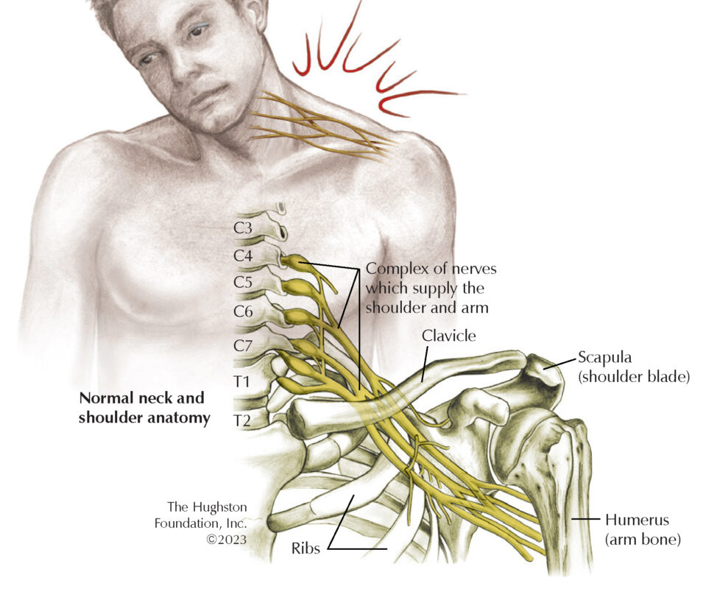

Motivation
Peripheral motor nerves power muscles
Injury or disease of nerves is permanently paralyzing
Nerve (mostly) cannot be simply repaired, but other redundant nerves may be surgically moved to power the paralyzed muscle
Nerve transfers—a type of microsurgery to “re-wire” the muscles
Re-innervation of the healthy nerve into the muscle is a slow process with uncertain results
Werner JM, Berggren J, Kim G, Loffredo K, Pascual M, Tiongson E, Seruya M (2020)
Notes:
This project was motivated by a clinical scenario.
We can think of peripheral motor nerves as the “electrical wires” that give energy to muscles, signaling them to move.
If peripheral nerves are severely injured or damaged, they do not simply recover. We cannot grow new neurons (nerve cells) to replace neurons that have died.
Without nerve giving its electrochemical signals to the muscle, the muscle is permanently paralyzed.
One option to give patients some recovery is a type of surgical procedure called nerve transfer. It requires highly specialized surgical techniques wherein the surgeon operates using a microscope to sew nerve together. The results can be a substantial improvement, but typically not 100% recovery of muscle strength. However, the recovery takes many months, up to 2 years, to see the full effects.
Despite this amazing surgical technology, if patients don’t learn to activate the muscle using the new nerve pathway, the surgery can ultimately be useless.

Slide 4
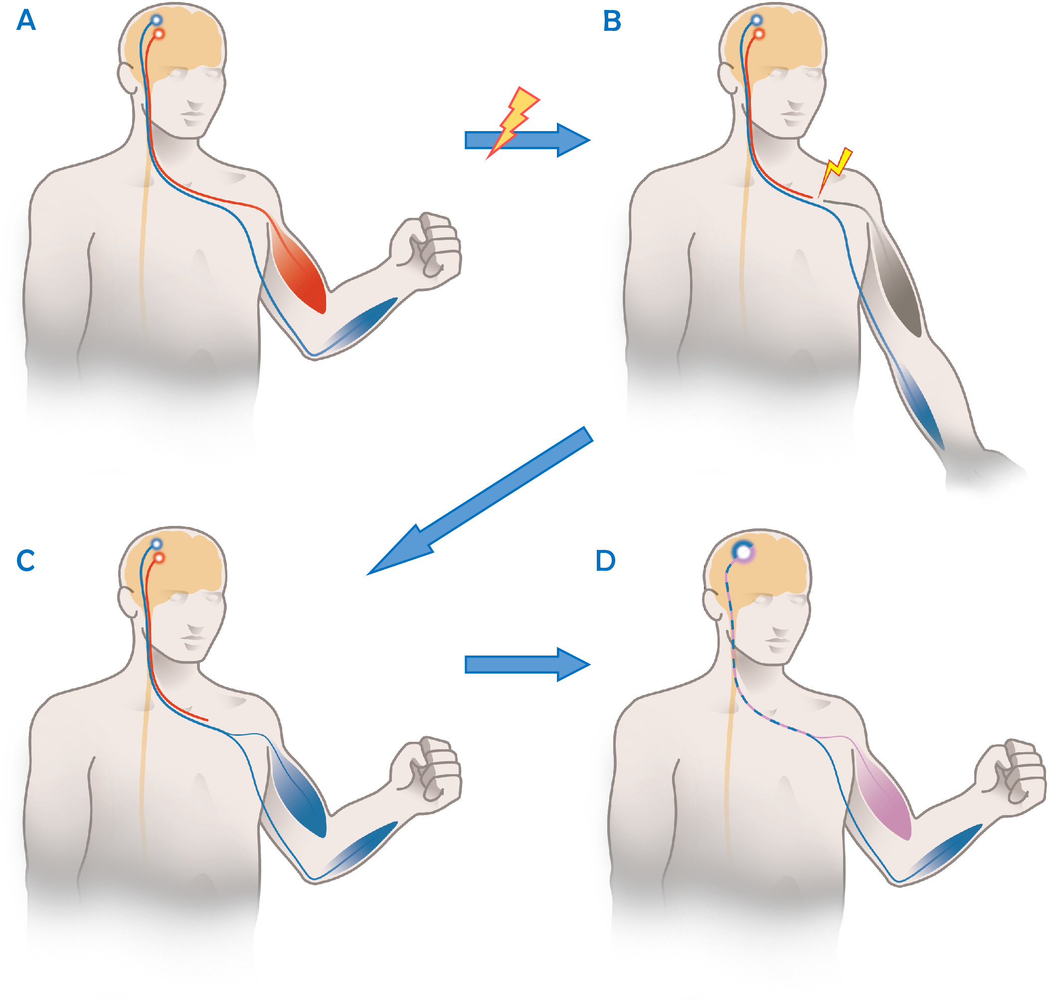
EMG Data from a Patient Who Underwent Nerve Transfer
6-year-old girl
Viral paralysis of one shoulder with transfer of medial pectoral nerve to axillary nerve
Surface EMG recorded from the deltoid (shoulder)
At rest (baseline)
Chest+shoulder (low)
Resistance added chest+shoulder (high)
Werner JM, Berggren J, Kim G, Loffredo K, Pascual M, Tiongson E, Seruya M (2020)
Notes:
The data for this specific project derive from a 6-year-old girl whose shoulder was paralyzed by a viral illness (enterovirus D-68). She had nerve transfer surgery. The surgeon portioned off part of her medial pectoral nerve, which controls the pectoralis minor (chest) muscle, and transferred it to the axillary nerve, which controls the deltoid muscle. Several months later when the nerve was branching into the deltoid (shoulder) muscle, she had to learn to move it. This meant that to learn how to move her shoulder, she actually needed to move her chest muscle.
EMG data for this project was recorded from the deltoid (shoulder) muscle at baseline, with attempted chest movement (where we would expect low shoulder activation) and resisted chest movement (where we would expect high shoulder activation)

Slide 5
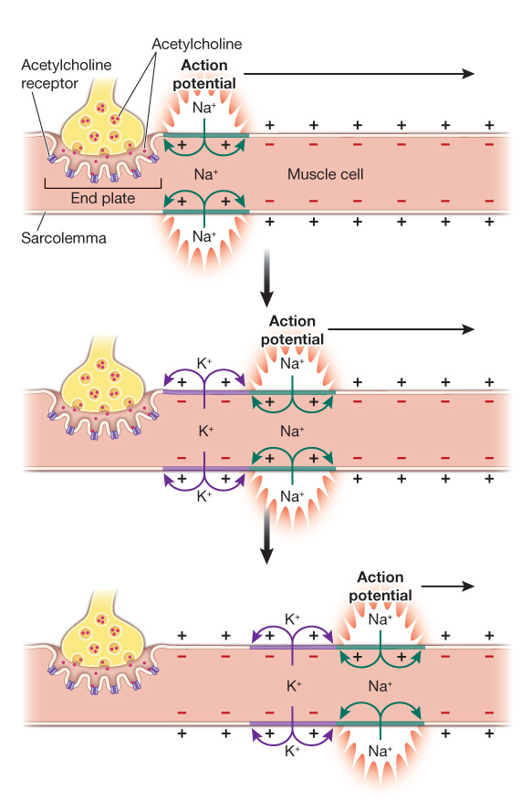
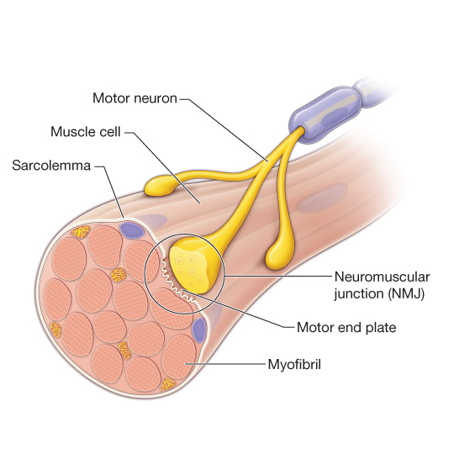
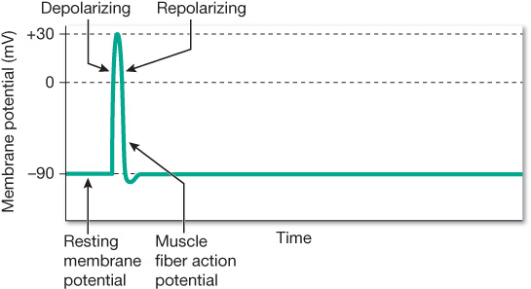
Physiology of Muscle
Action potential—electrical impulse that travels along a motor neuron, causing depolarization of the muscle cell
Kandel ER, Koester JD, Mack SH, Siegelbaum SA (2021)
Notes:
Muscle cells are also called muscle fibers, because they are large, multi-nucleate cells that are as long as the muscle segment. They look like fibers.
Every skeletal muscle cell has one point of contact with a motor neuron that controls it. An electrochemical signal is propagated down the neuron, and transmitted to the ”motor end plate” (this is the neuromuscular junction) between the neuron and the muscle cell. This causes a depolarization of the resting potential of the cell membrane of the muscle cell. The action potential then propagates from the neuromuscular junction, along the length of the muscle fiber. In other words, it propagates a wave along the muscle cell.

Slide 6
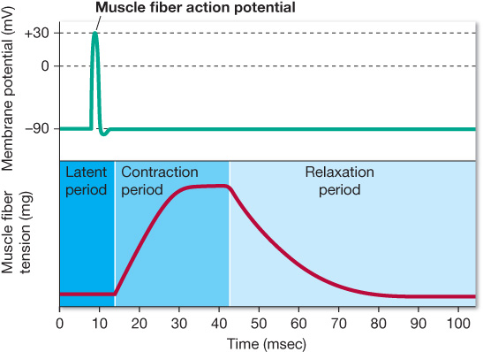
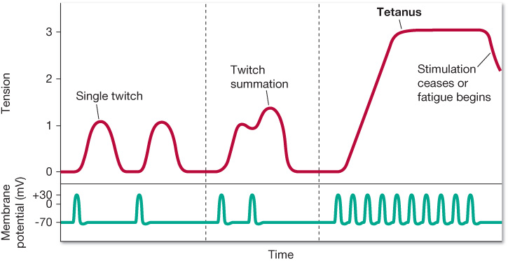
Physiology of Muscle
Relaxed muscle demonstrates periodic firing
Action potentials are 1-5 ms
Muscle fiber contraction-relaxation sequence is 30-200 ms
Subsequent action potentials can be propagated along the muscle fiber before the contraction sequence is completed
Kandel ER, Koester JD, Mack SH, Siegelbaum SA (2021)
Notes:
The action potential, or firing, typically occurs many times repeatedly. With greater effort, the time between action potential spikes becomes shorter as spikes become more frequent. A single muscle contraction sequence is called a ”twitch.” When many firings or twitches occur in short succession, the power of the muscle increases through twitch summation. Many successive twitches summed together creates muscle tetanus, with means the muscle is ON.
Note that this image on the bottom left is showing several successive action potentials and their summative muscle tension graph FOR A SINGLE MOTOR UNIT.

Slide 7
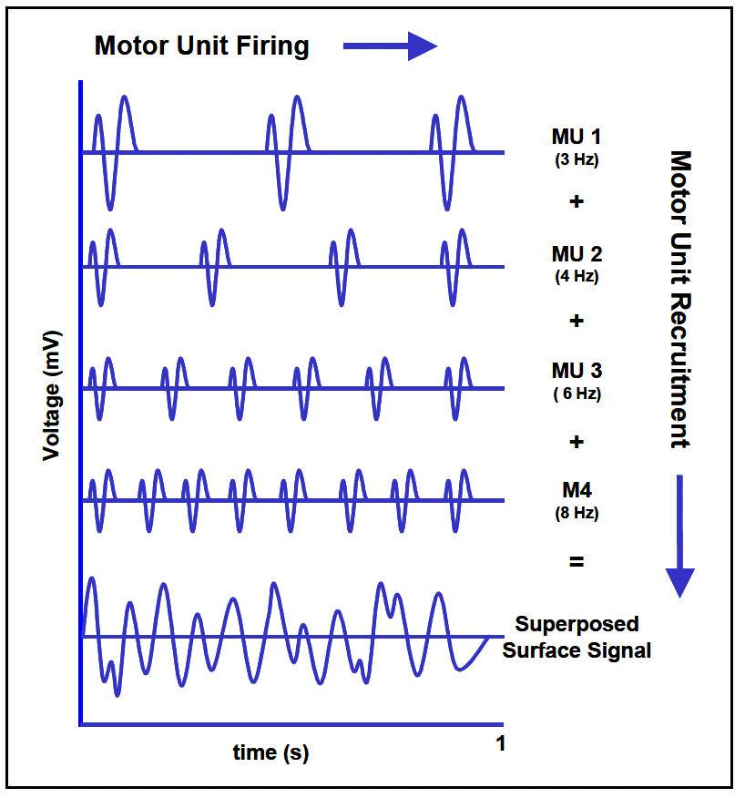
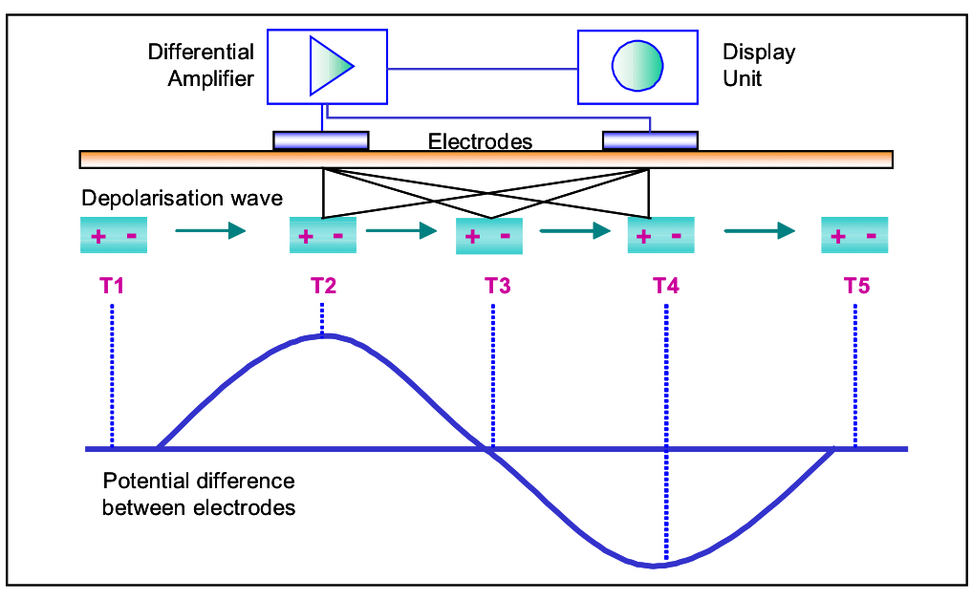
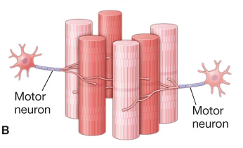
Muscle Activity to EMG Signal
Interference signal—the coalescence of many different motor units
Electrical dipole—forms an electrical potential difference between the spaced electrodes
Stern RM, Ray WJ, Quigley KS (2001)
Notes:
When we record from the surface, we are recording an interference signal, which is the summation of multiple motor units. Multiple motor units are recruited and the firings of single motor units coalesce to produce a complex waveform that is no longer easily interpretable as a single motor unit. This superposition of multiple motor units is what we are actually recording in EMG.

Slide 8
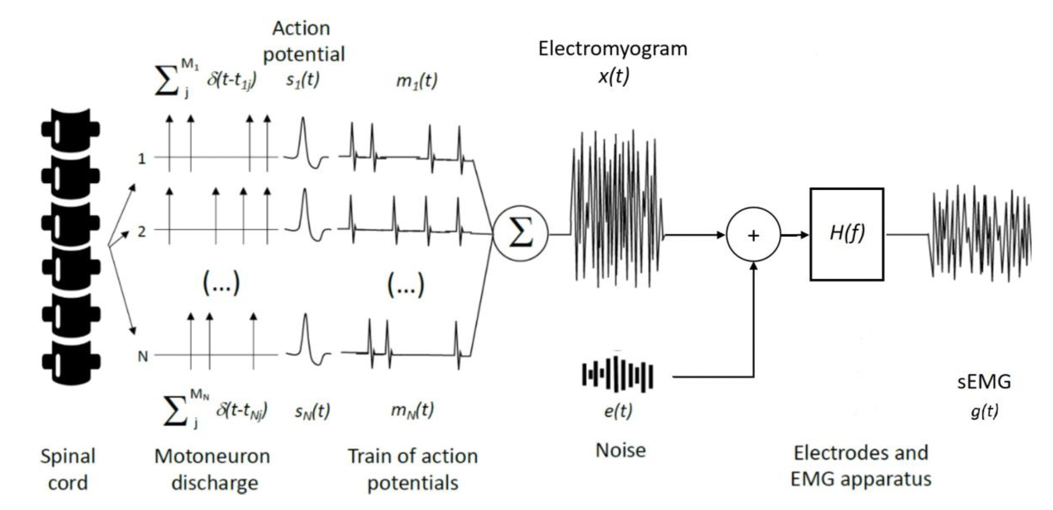
EMG Recording Procedure
Electrodes
Leads
Raw EMG signal
Signal amplification
Filtering (band pass)
Sampling (digitizing)
Pre-processed EMG signal is recorded
Stern RM, Ray WJ, Quigley KS (2001)
Notes:
We have discussed how motor neurons create action potentials, which give rise to muscle cell activation, and these signals are superpositioned to create the EMG signal. There is also environmental noise from electrical appliances and just general background electrical noise. This is the signal passed to the electrodes and EMG apparatus. Next, the computer system needs to amplify the signal. It is also sent through a band-pass filter designed to collect data only in the typical range of muscle activity (typically 20-500 Hz or 20-250 Hz). It is then digitized and a sampling rate has to be chosen. In our data, this was 2048 samples per second. Finally, this pre-processed EMG signal is recorded, and this is our data.

Slide 9
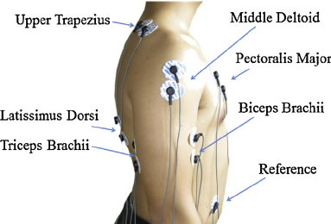
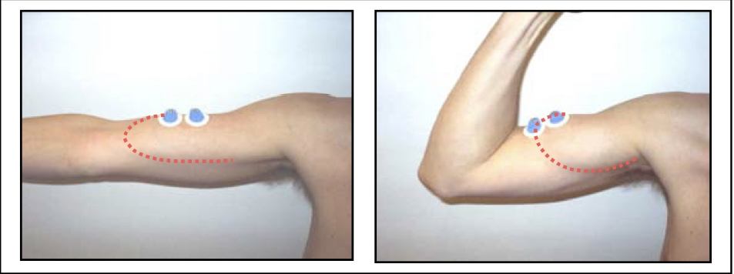
EMG Recording Considerations
Tissue characteristics
Electrode impedance (≤5000 Ω)
Electrode arrangement: parallel to muscle fibers
Electrode position
Amplification—gain adjusted to account for <50 μV up to ~1000 μV
Signal-conditioning filter—band pass 20-500 Hz
Sampling rate—sparse sampling will lead to aliasing effects
Stern RM, Ray WJ, Quigley KS (2001)
Notes:
There are many sources of possible noise and variation in EMG recordings.
Tissue characteristics—fat tissue, muscle tissue thickness, location of tissue relative to other sources of “cross-talk”, such as pulses. Dry/dead skin, hair, oil.
Ag-AgCl electrodes are used for stability and low impedance, which are “floated” over the skin with conducting gel and attached with adhesive.
Electrode arrangement must be parallel to muscle fibers to reflect the direction of electrical dipole travel
Electrode position--Electrodes centered over the muscle belly, ensuring that the muscle doesn’t move out from under the surface electrodes during contraction
Amplifier gain might not be possible to set so that it covers the full range
Filter electrical noise below 20 and above 500 Hz. There is background noise at 60 Hz (U.S.) from electrical devices.
Sampling rate = 2048 samples per second

Slide 10
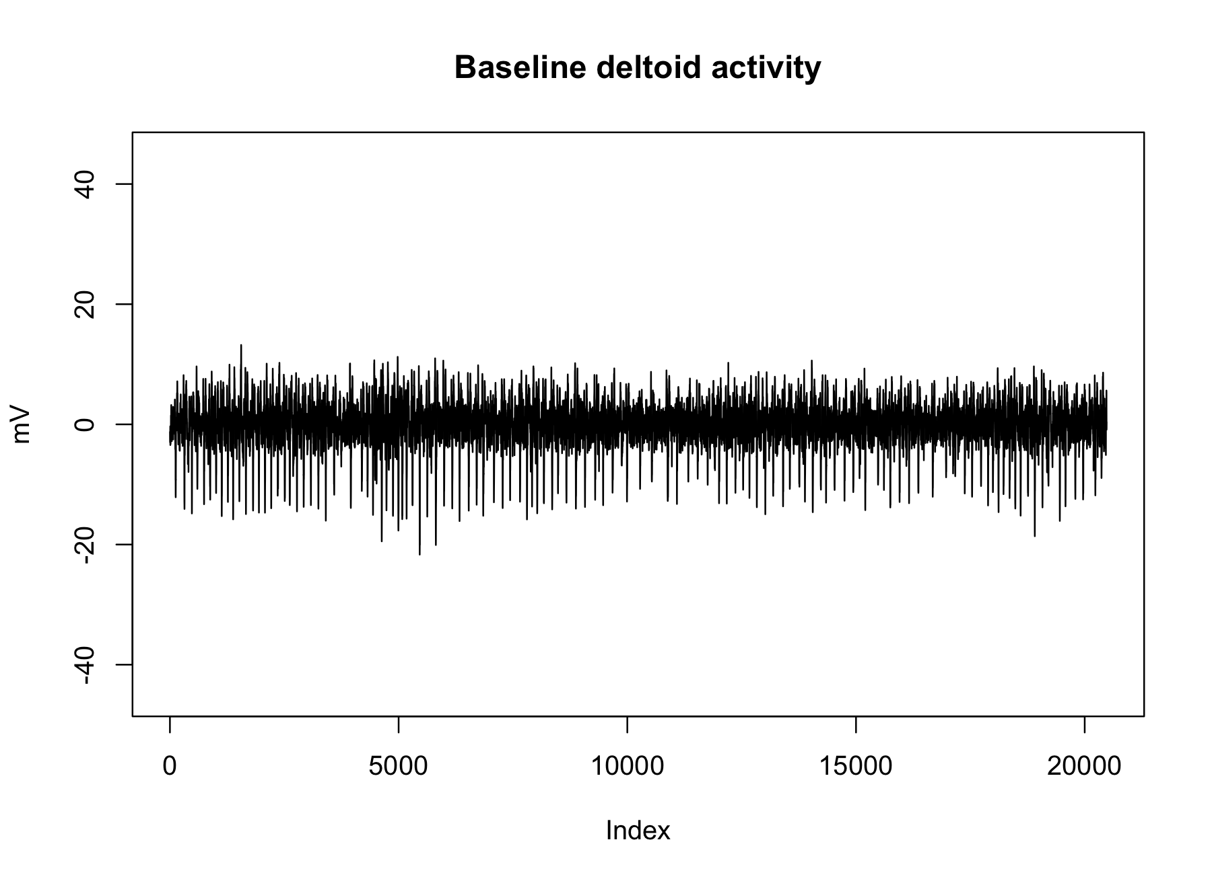
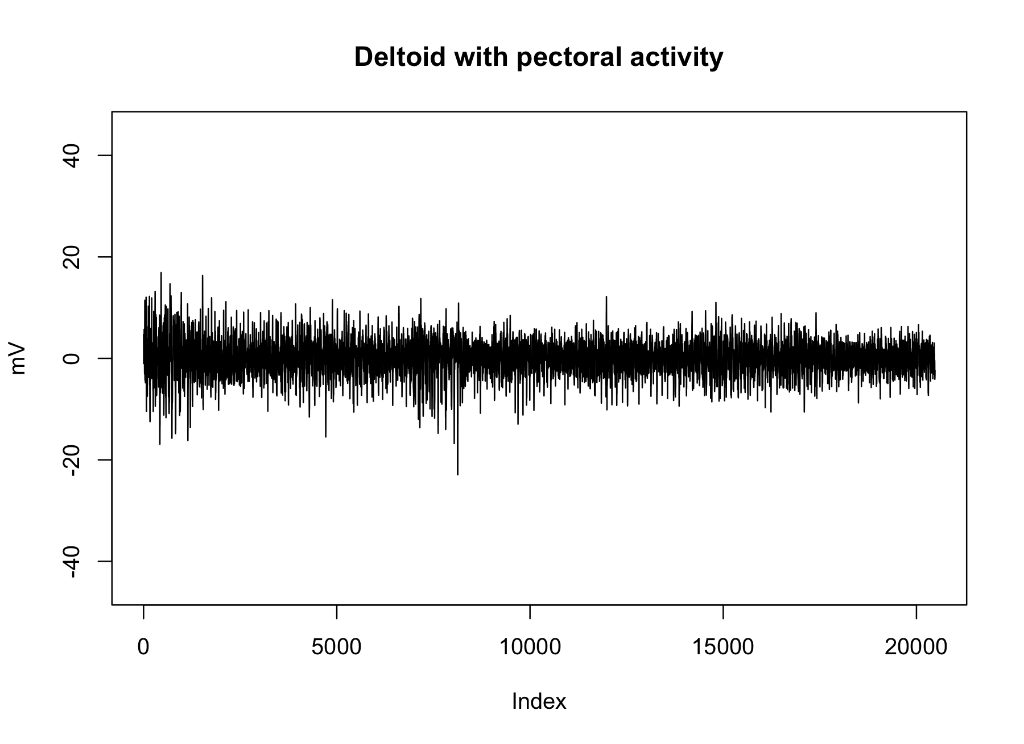
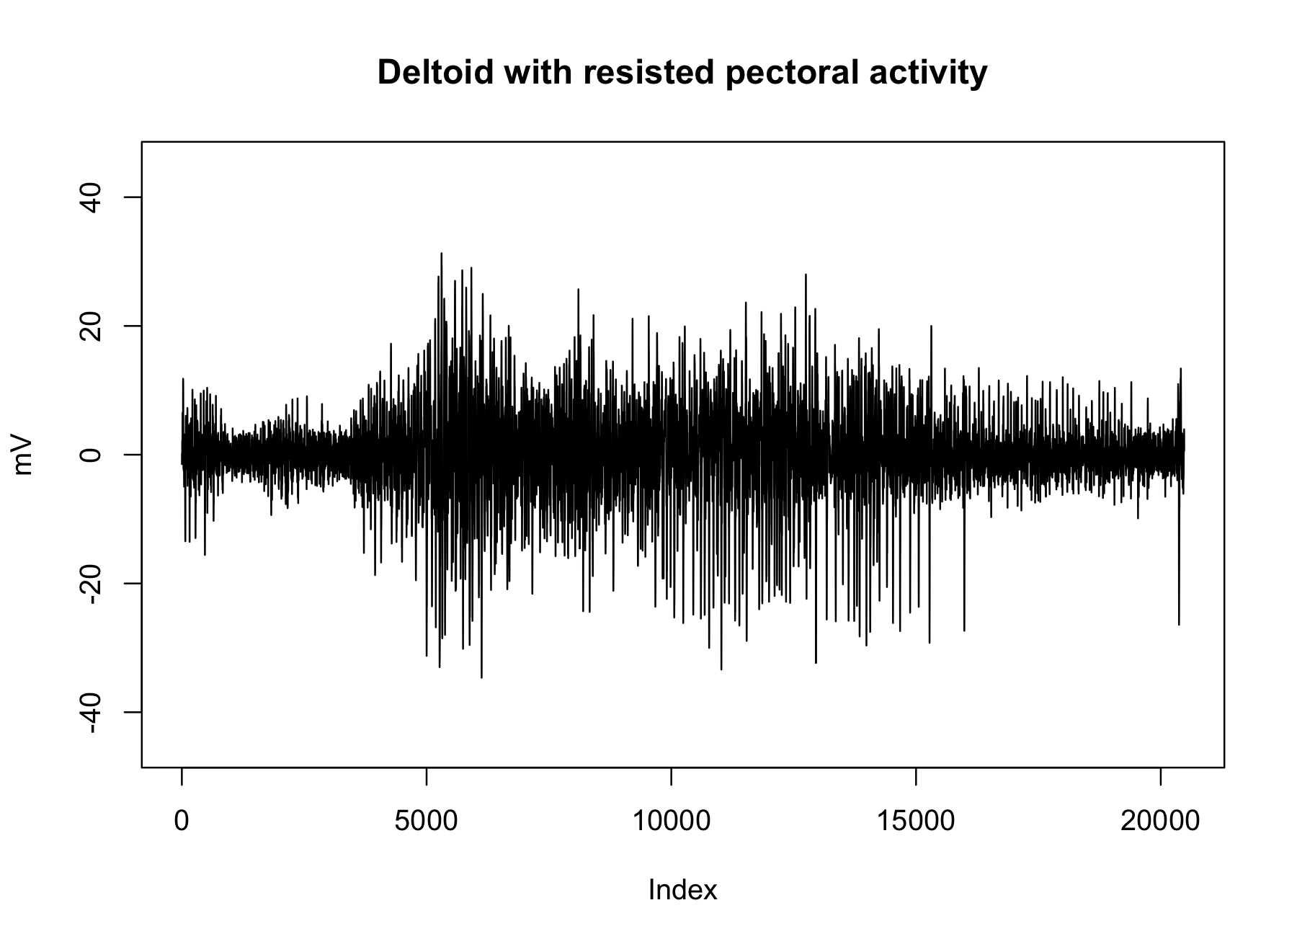

Details of Dataset
Single session of surface EMG recordings from the deltoid (shoulder) muscle
Old, poorly documented, not collected for research
Likely many unknown sources of error
Recorded during prompted movements
Start and stop times of each movement were flagged manually on keyboard
Exploratory data analysis revealed possibly different patterns during different movements →Data analyzed was from deltoid+pectoral and deltoid+pectoral+resistance
+
+
Notes:
The data for this project were from a single EMG recording session lasting 19(?) minutes.
This data was not collected for research purposes, and was a few years old, so there may be some information lost. There are likely many unknown sources of error.
The data were recorded when the child was prompted to move, and a person manually pressed a key to log when movements started and stopped.
Our exploratory data analysis revealed that there were indeed visually distinct patterns based on the logged movement events. We decided to use the data tied to events when the child was moving her shoulder with her chest muscle, and when she was moving her shoulder with her chest muscle against resistance. These two epochs are likely to include periods of “ON” and ”OFF” activity of the muscle, as well as possibly relatively lower and higher activity.

Slide 11

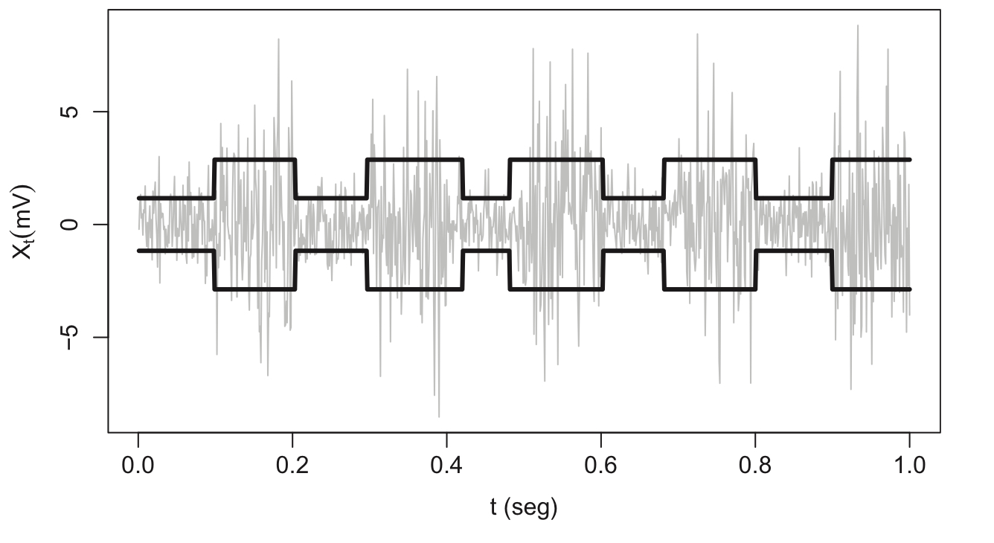
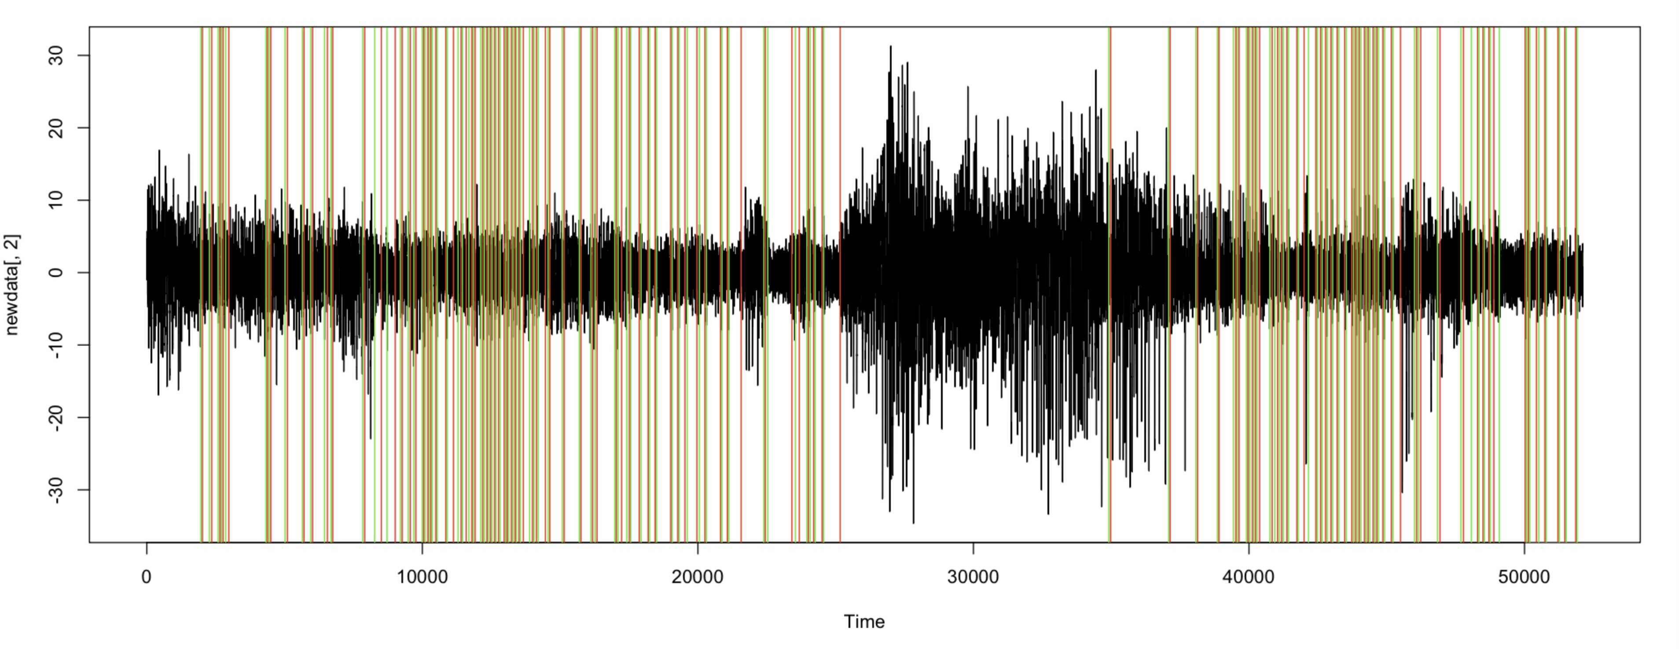
Background on Method
Search for methods to analyze EMG → biosignalEMG R package
Package includes function for detecting activity patterns in EMG
Heteroscedastic change-point model
Assumes normally-distributed time series data with non-constant variance, which is used to determine signal phase
vertical lines represent On/Off times
Results from package developer using synthetic data
Results from our attempt using the package
on our
data
Esquivel-Frausto ME, Guerrero J, Macias-Diaz J (2010); Guerrero, & Macias-Diaz (2014)
Notes:
We found an R package of tools designed to analyze the data, but it is unclear EXACTLY what the R package was doing.
The examples from the package developer are perfect, but they used synthetic data.
When we first tried this on our real data, the results suggested hundreds of On-Off cycles that were nearly meaningless for our interpreting our data.
The biosignalEMG package did not offer many options for tuning hyperparameters.
We decided to code our own algorithm, following two papers cited in the package documentation. This gave us better control over the phase-detection algorithm.

Slide 12
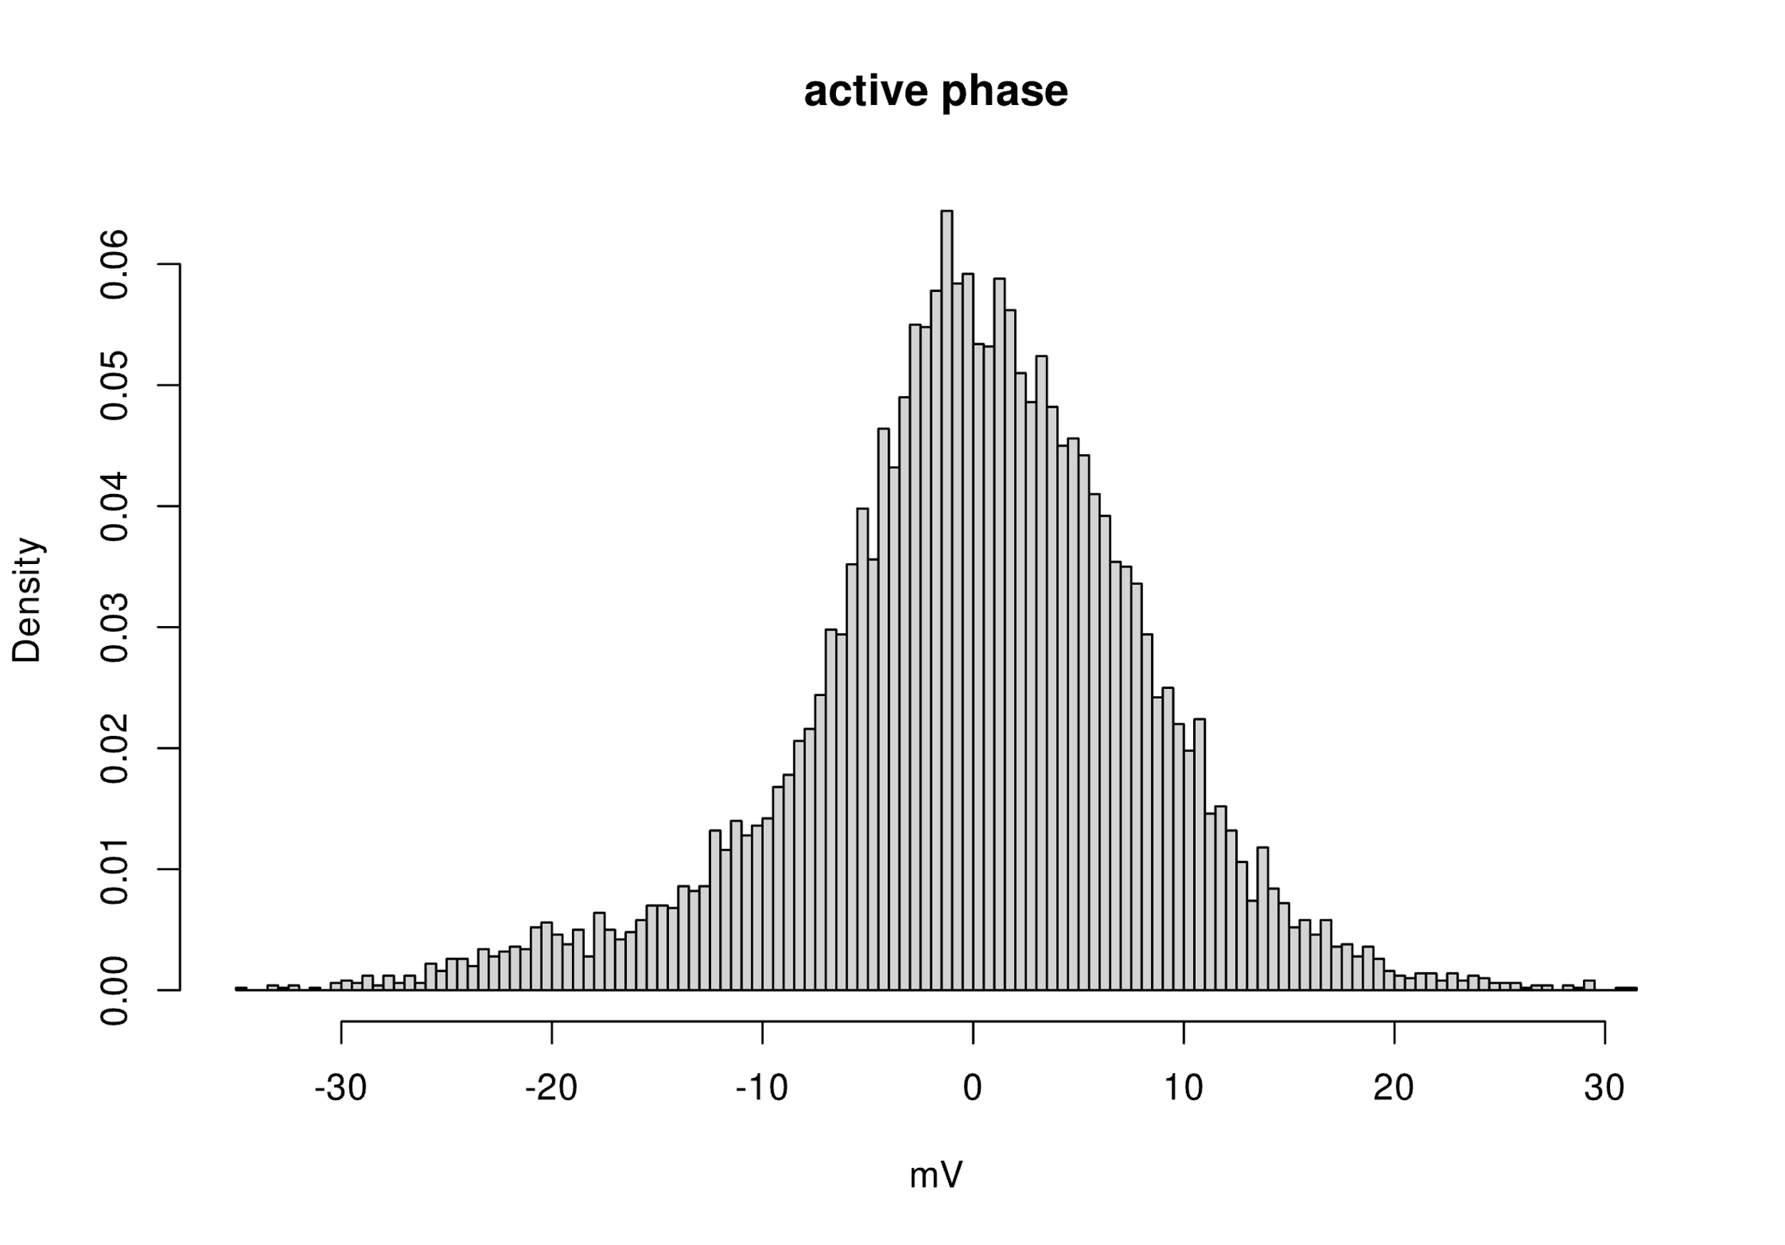
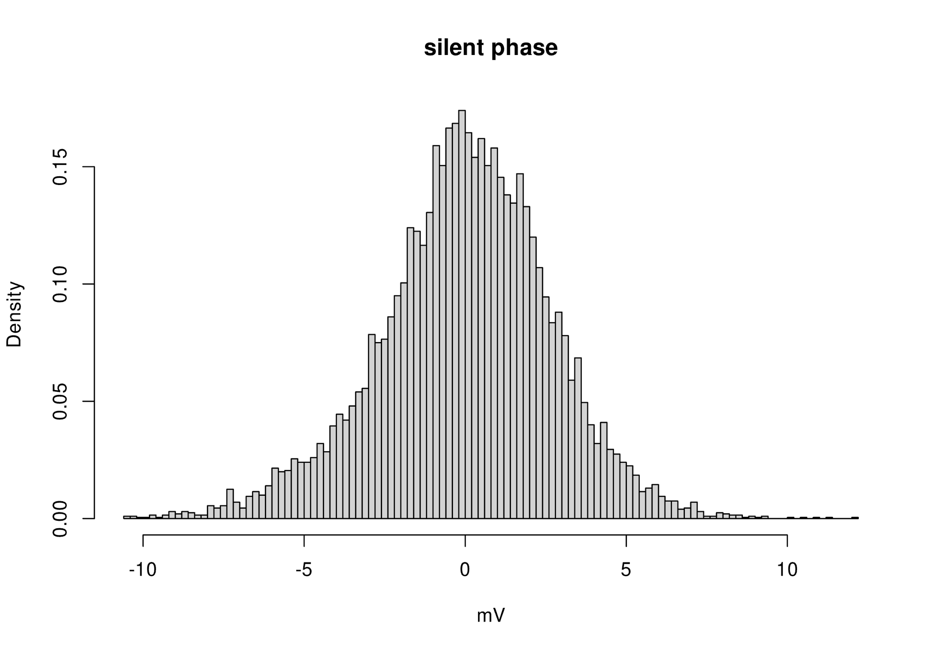
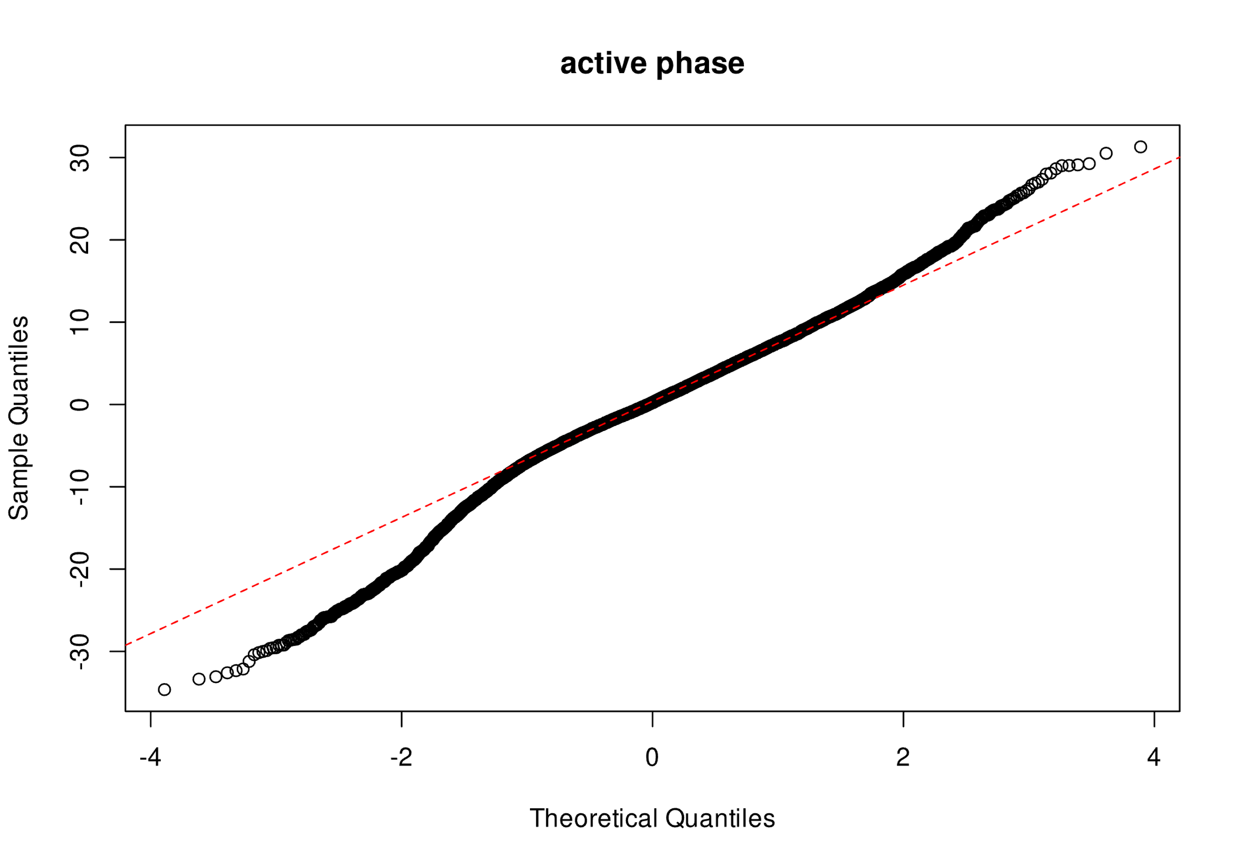
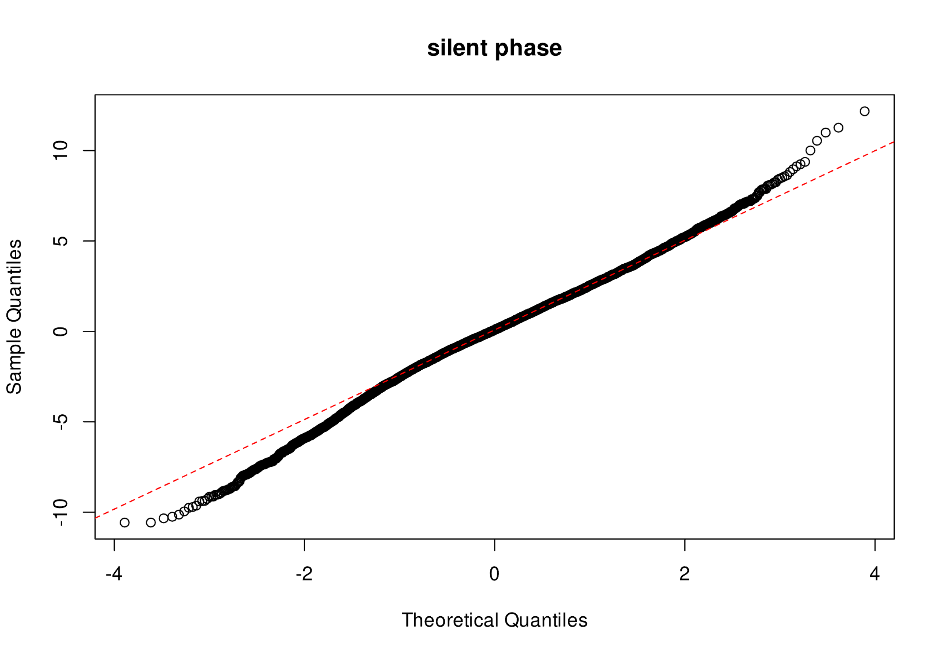
Method
Assumptions: time-dependent, normally-distributed (within phase), non-constant variance (across phases)
Active phase var = 67.227 Silent phase var = 7.205
10000 samples (~4.9 seconds, at 2048 samples per second) each, manually identified as periods of relative “silence” and “activity”
Notes:
To begin, we noted that the literature describes EMG data as being normally-distributed. This is a function of the arbitrary firing of neurons and the signal summation occurring at different muscle fibers. We assessed normality by “eyeballing” the data for a 10000-sample silent phase and a 10000-sample active phase. It was not *too* far from normal, but certainly not as perfect as the synthetic data used by the paper authors, on whose work we based our analysis. It is a bit leptokurtic, meaning it highly peaked with thin tails. There may be some additional left skew in the active phase data.

Slide 13
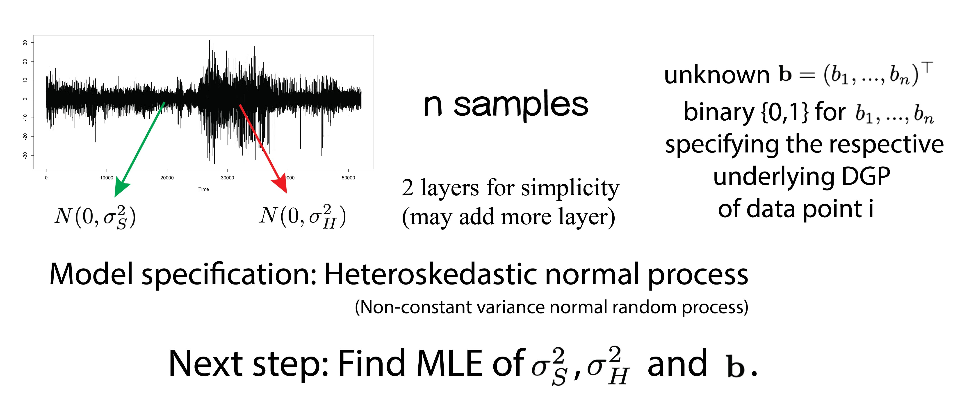
Method
Esquivel-Frausto ME, Guerrero J, Macias-Diaz J (2010); Guerrero, & Macias-Diaz (2014)
Notes:
Change-point estimation has been used to detect values of sequences where there is a change in the probabilistic distribution of the data.
An EMG signal is a sequence where each component is a measurement of the electrical activity at a given time, t.
We assume that EMG is a sequence of normally distributed random variables, which may be independent within phases of like activity.
However, phases of “activity” and “silence” are known to occur, with a common probability distribution within phases, but different distribution between phases.
Next, we wish to find the MLEs to best estimate our parameters.

Slide 14
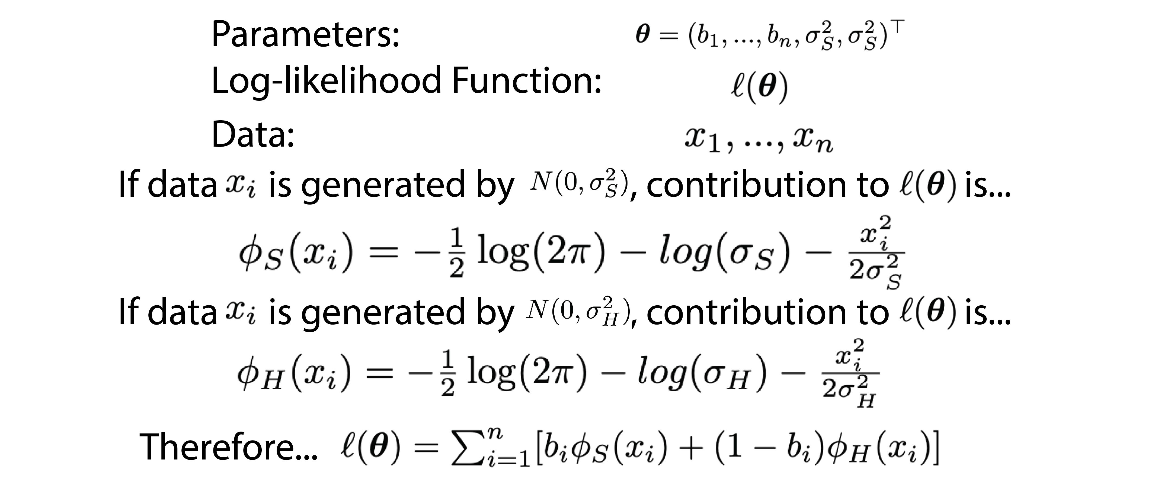
Log-likelihood function
Esquivel-Frausto ME, Guerrero J, Macias-Diaz J (2010); Guerrero, & Macias-Diaz (2014)
Notes:
The log-likelihood function is defined here.

Slide 15
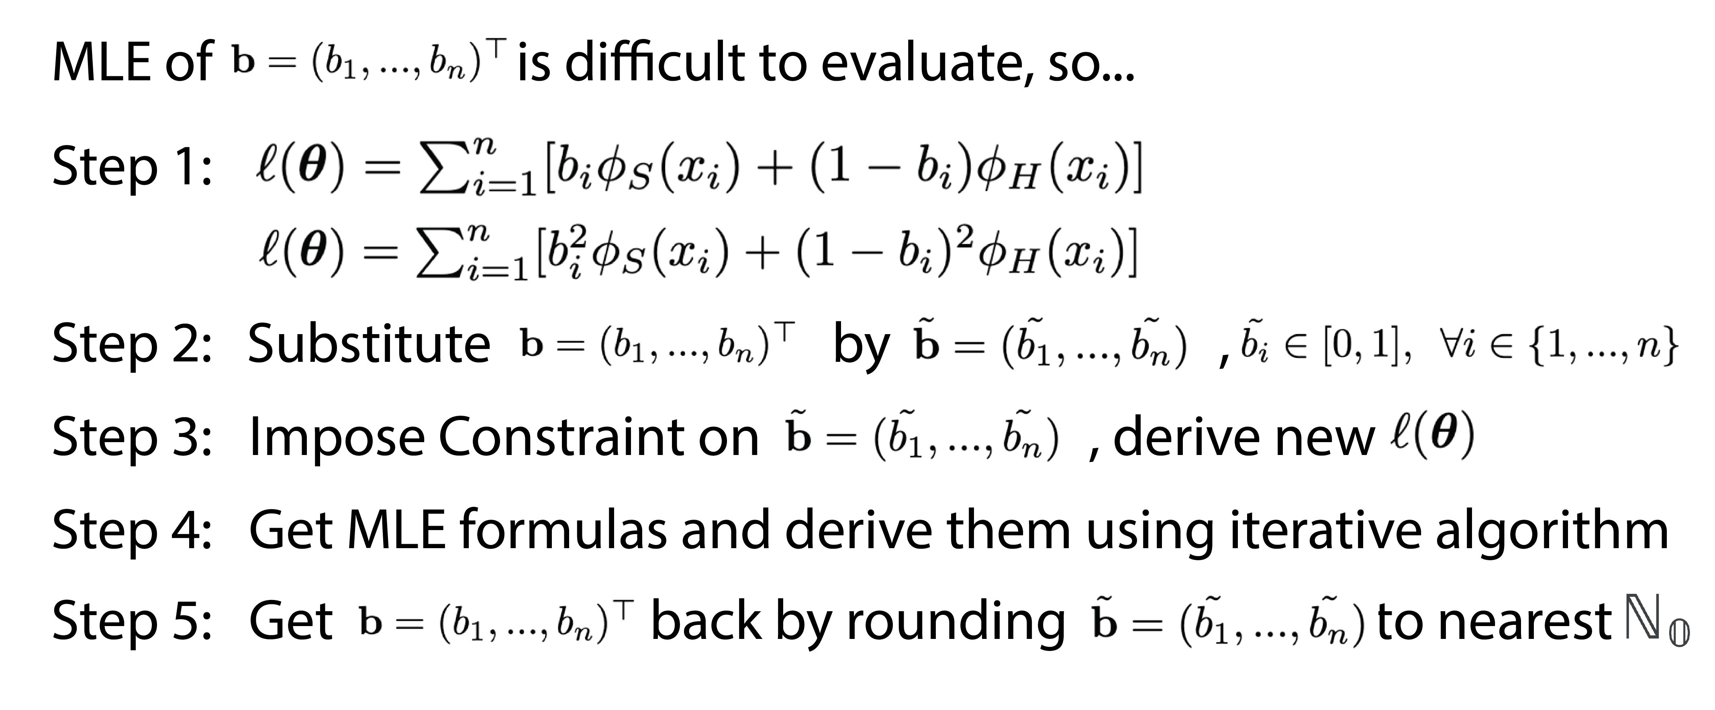
Evaluation of indicator MLE
Esquivel-Frausto ME, Guerrero J, Macias-Diaz J (2010); Guerrero, & Macias-Diaz (2014)
Notes:
We note that the log-likelihood function is a rather difficult task to maximize because of the indicator functions, represented by vector b.
This would be a tricky combinatorial problem.
The solution proposed by the paper authors (which we follow) is to substitute an n-dimensional vector of continuous values, b.tilde, with constraints.
This allows for close approximation to the exact solution.
From here, we can derive the MLEs subject to the constraints, round the b.tilde values to the nearest natural number (0 or 1), and substitute them back in.

Slide 16
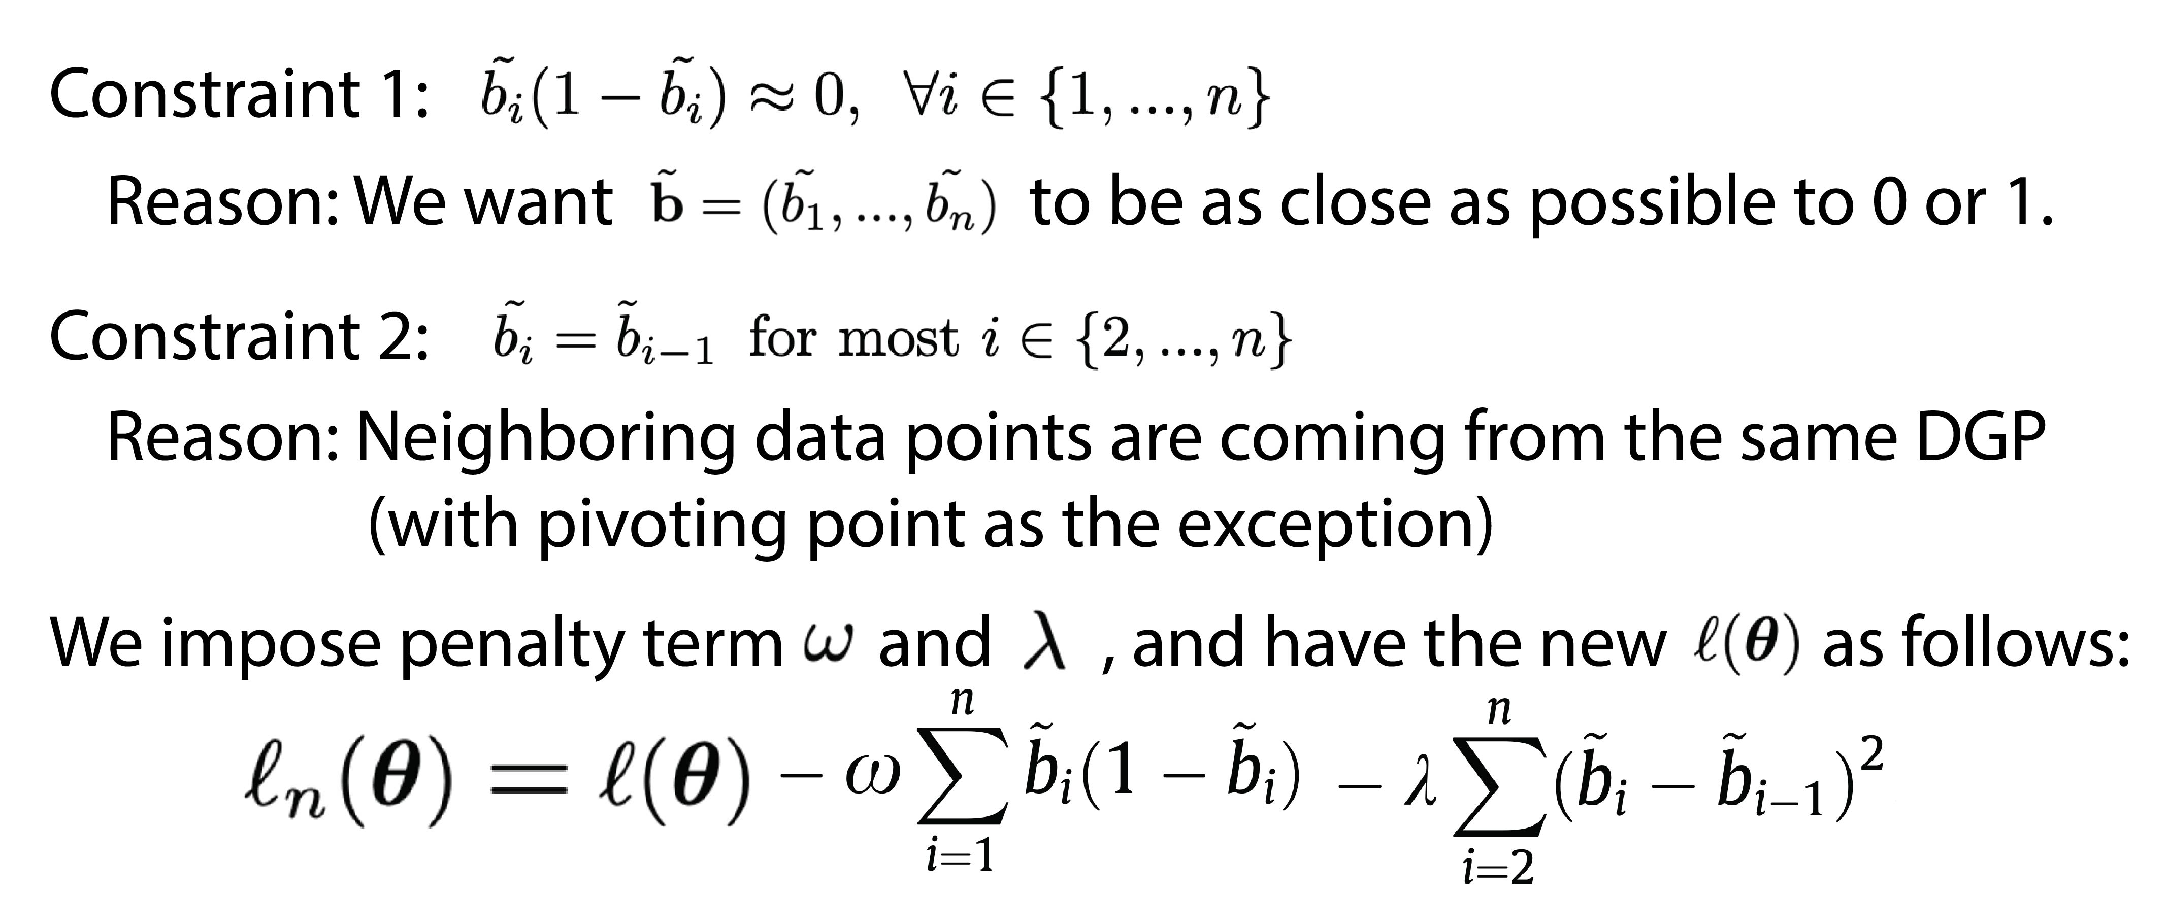
Constraint for indicator substitution
Esquivel-Frausto ME, Guerrero J, Macias-Diaz J (2010); Guerrero, & Macias-Diaz (2014)
Notes:
Specifically, for b.tilde to perform similarly to b, we require that each b.tilde be in the closed interval [0,1].
Additionally, b*(1-b) should be near to zero, as would be the case with the indicator functions.
We then impose penalty terms, omega and lambda, on the constraints.

Slide 17
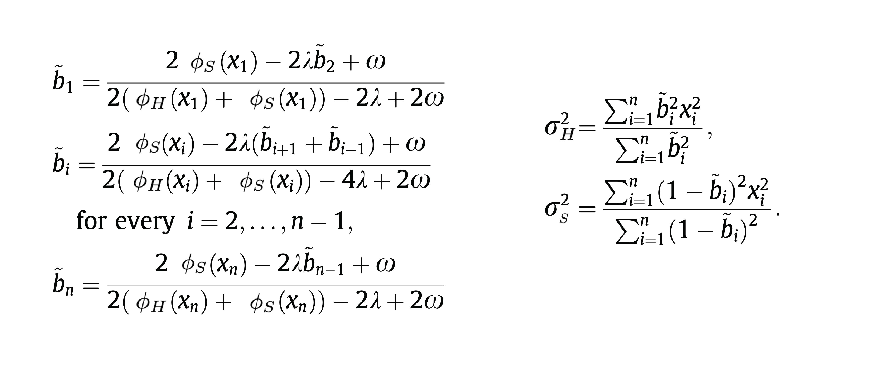
MLE formulas
Esquivel-Frausto ME, Guerrero J, Macias-Diaz J (2010); Guerrero, & Macias-Diaz (2014)
Notes:
The resulting MLE formulas are obtained.

Slide 18
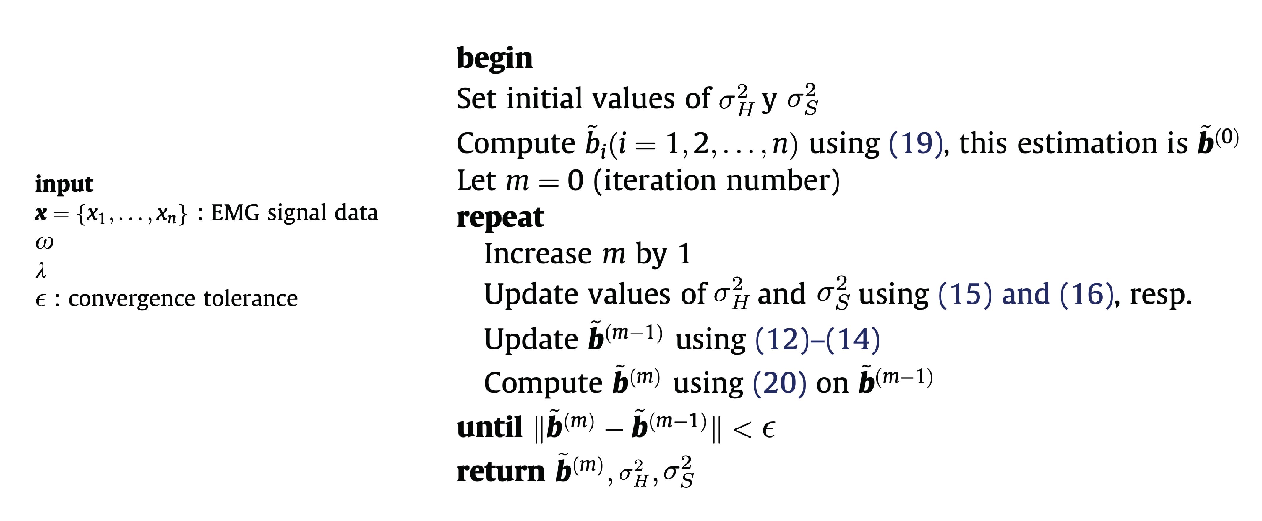
Iterative Algorithm
Esquivel-Frausto ME, Guerrero J, Macias-Diaz J (2010); Guerrero, & Macias-Diaz (2014)
Notes:
In summary, the iterative algorithm is outlined as shown here. Beginning with the data (x); penalty terms (omega and lambda), and choosing a convergence tolerance.
We set initial values of variance corresponding to the ”active” and ”silent” phases.
Next, we compute the initial components of the b.tilde vector as a proportion of total variance.
The iterative process begins, updating variance terms and b.tilde (classification terms) until convergence is achieved within a tolerable error range.

Slide 19
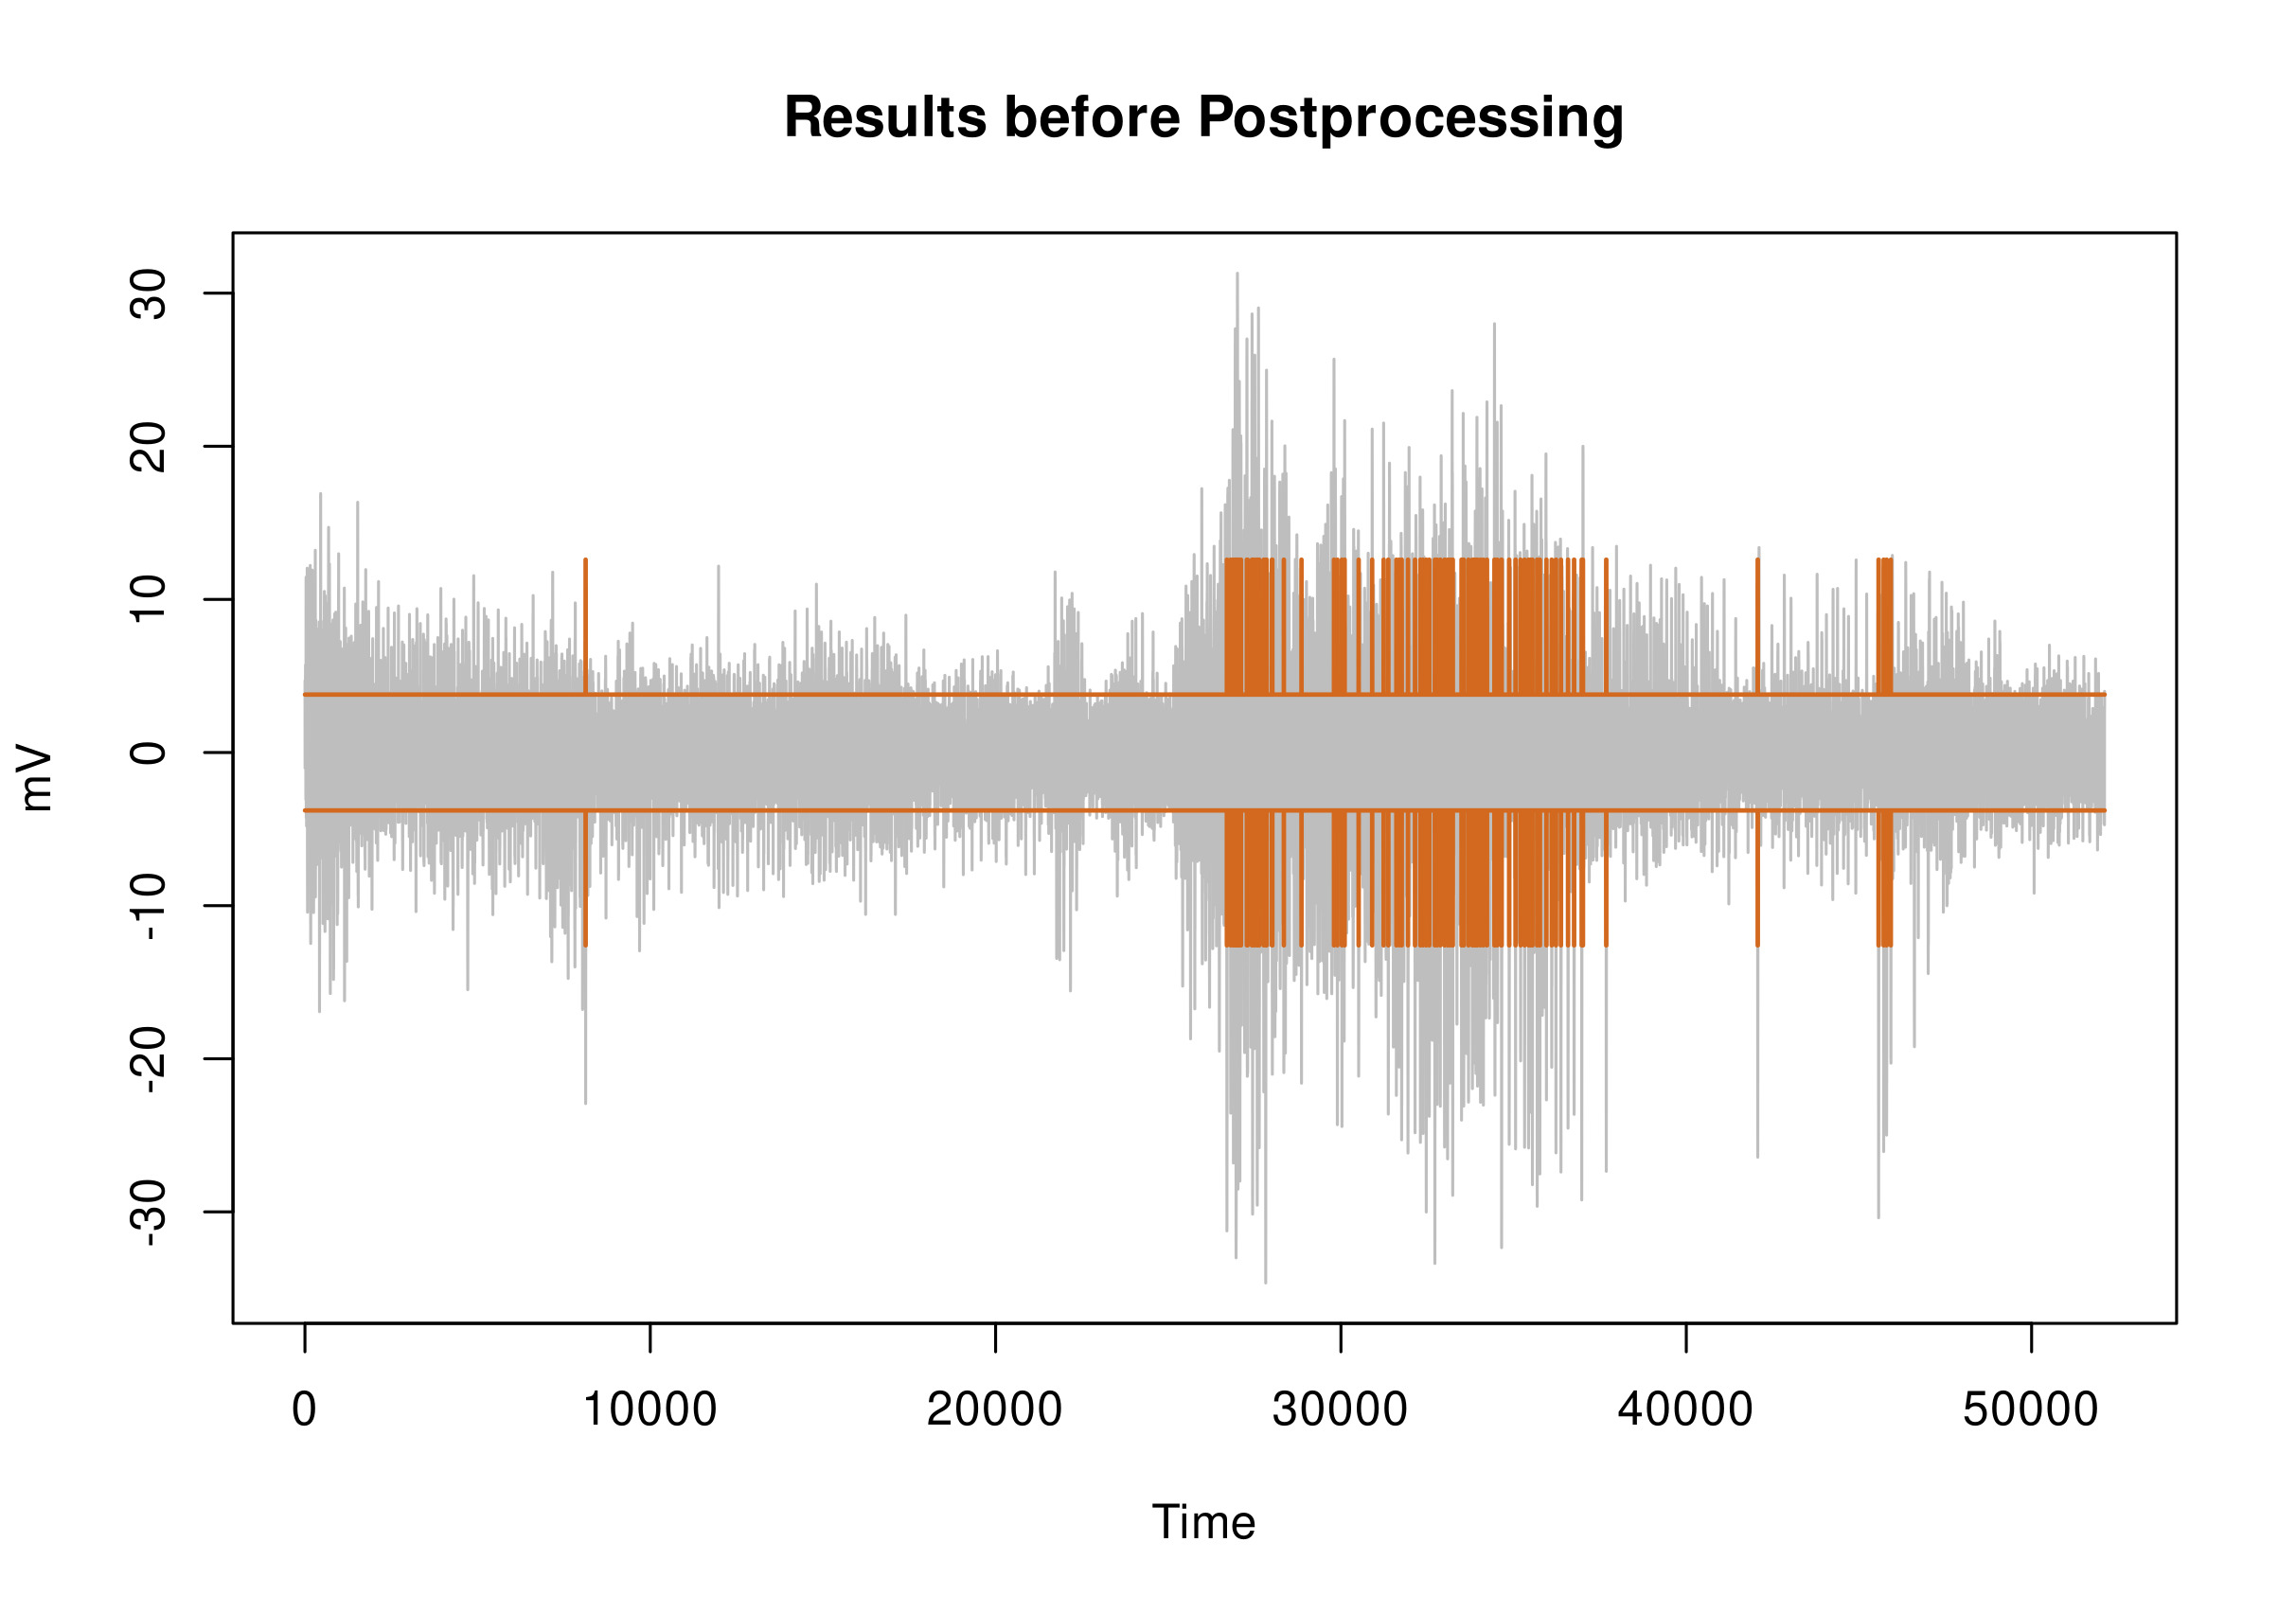
Results…
Should ensure that the phases are coherent and smooth over noise.
Obviously some postprocessing is needed…
Esquivel-Frausto ME, Guerrero J, Macias-Diaz J (2010); Guerrero, & Macias-Diaz (2014)
Notes:
Here we see the initial results of the iterative algorithm for indicating phases of signal “silence” and “activity,” along with the variance terms of each.
It is obviously less than ideal. The presence of noise and electrical interference, from the environment and nearby muscles, is affecting the tidiness of the outcome.
Following the paper authors, we need to employ a posteriori processing.

Slide 20
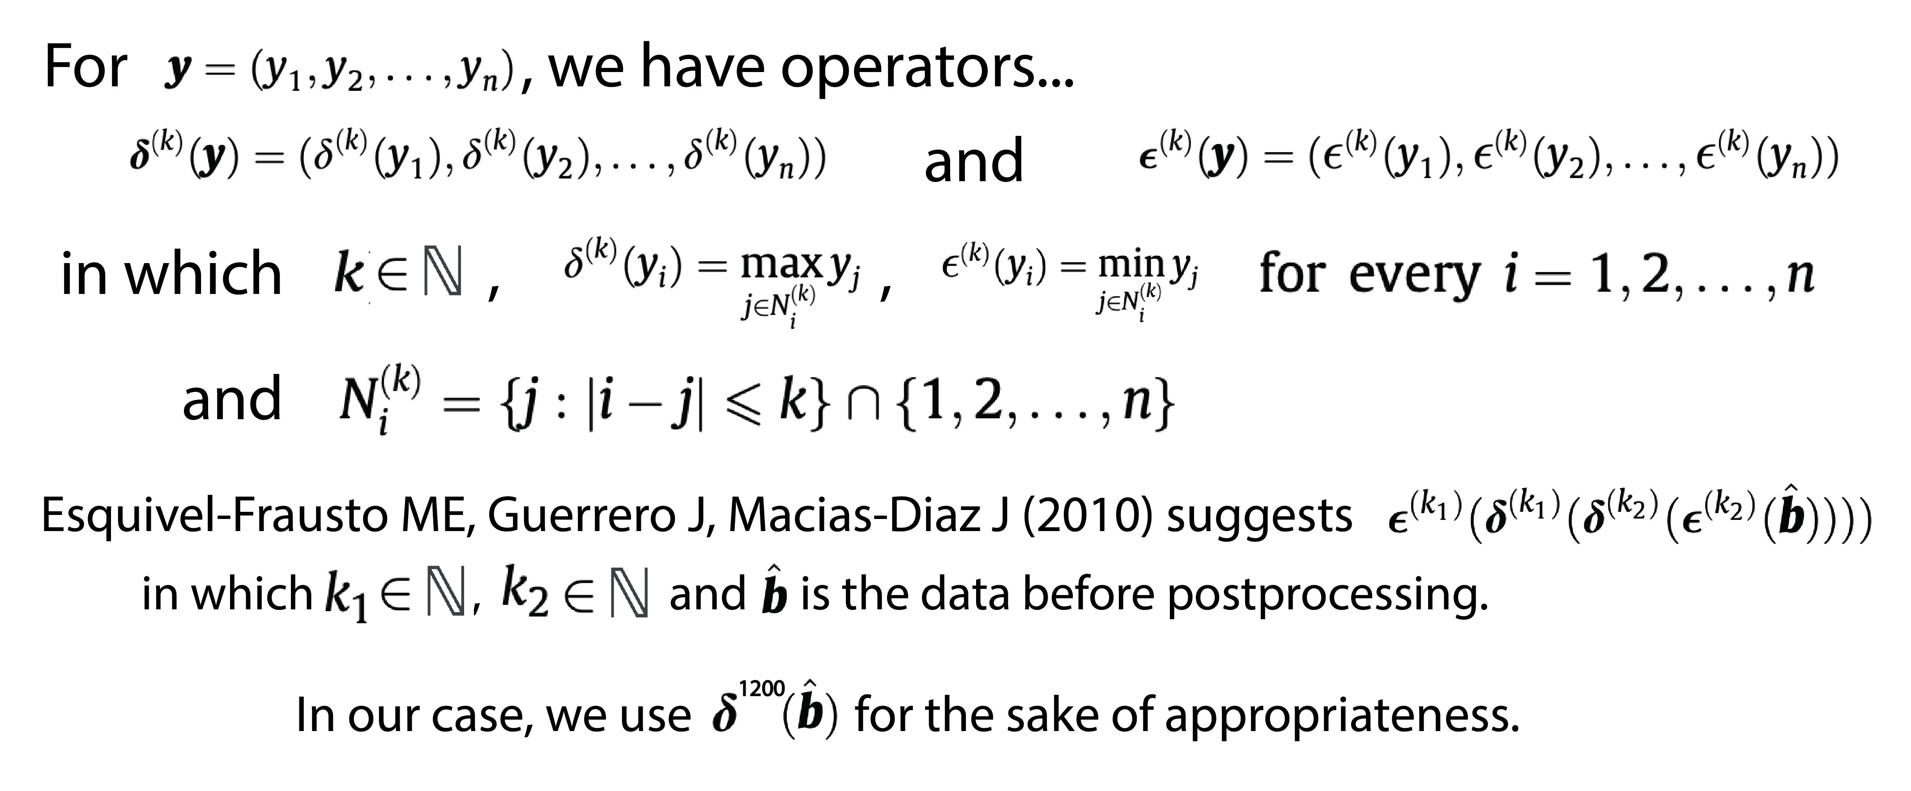
Postprocessing operator
Esquivel-Frausto ME, Guerrero J, Macias-Diaz J (2010); Guerrero, & Macias-Diaz (2014)
Notes:
The Authors suggested successive dilation and erosion operators to ensure that short sequences of On/Off are smoothed over to more meaningful continuous phases. We found in our data that only the dilation operator was appropriate for our data, and employed this method.

Slide 21
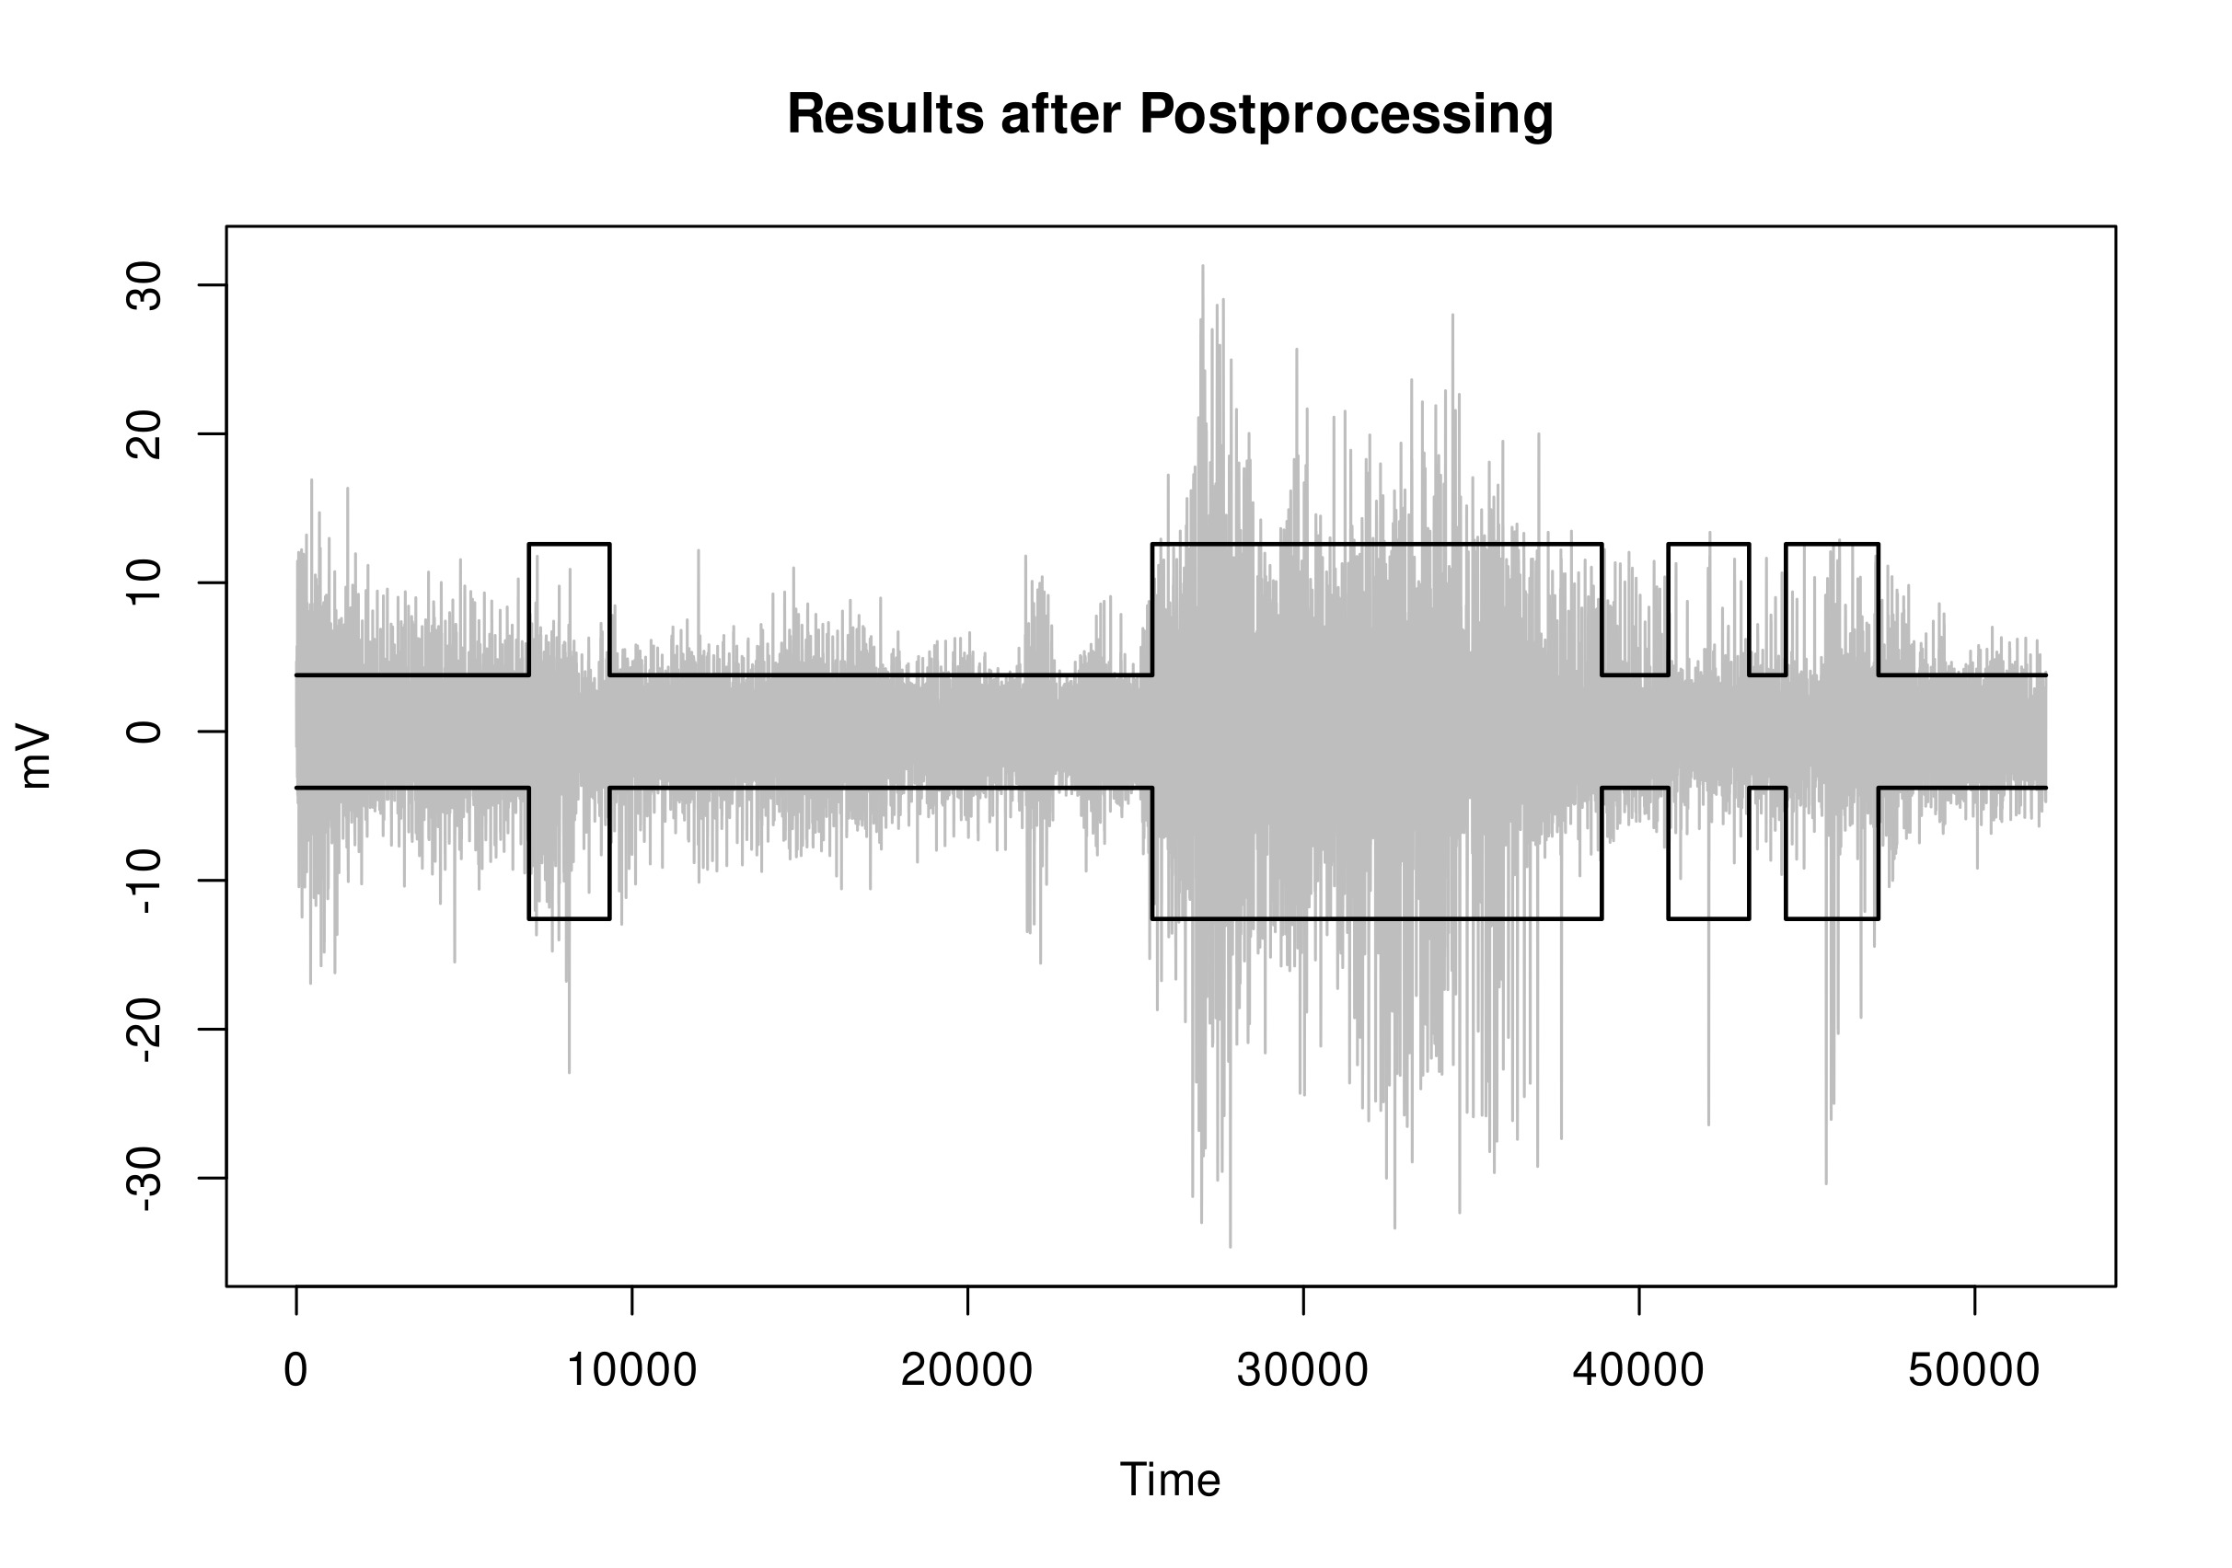
Results after postprocessing
Nice~
Esquivel-Frausto ME, Guerrero J, Macias-Diaz J (2010); Guerrero, & Macias-Diaz (2014)
Notes:
Note that the post-processed data now clearly delineates periods of relative “silence” and “activity.”
From here we can debate if this algorithm was of good quality.

Slide 22
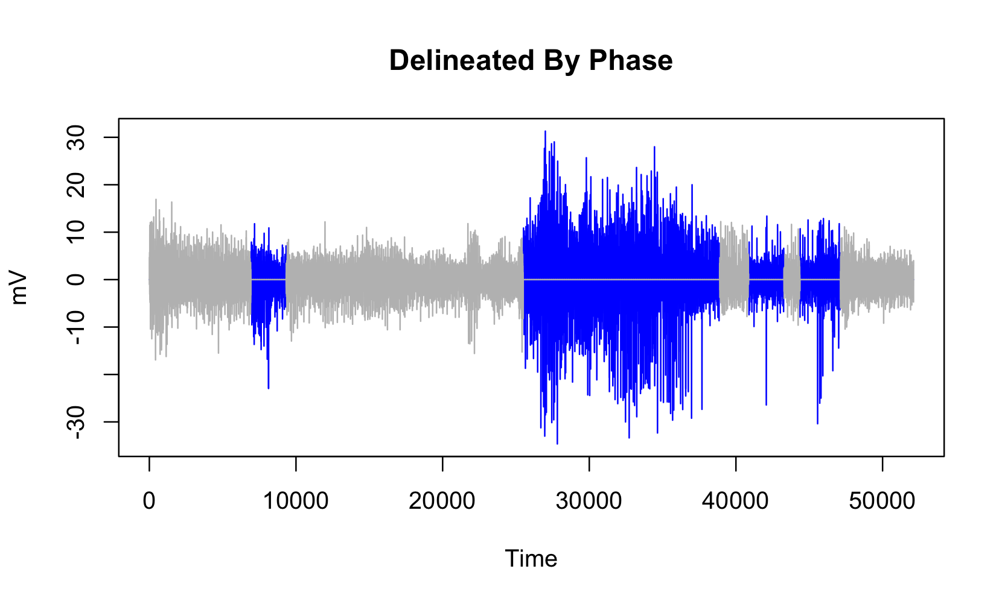
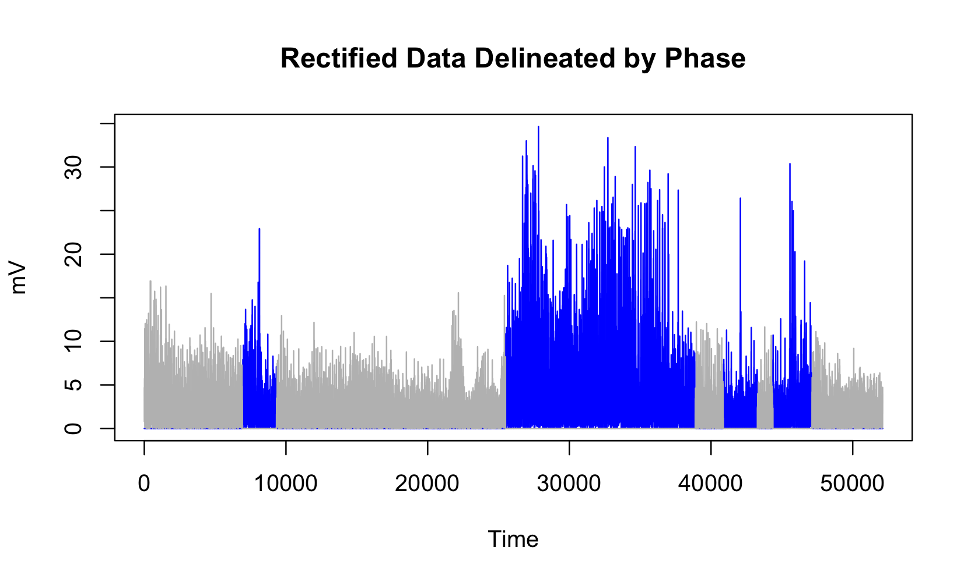
Results
Evaluate results: assess model performance & use On/Off detection for inference
Percentage of classification error?
Would require knowledge of “true” On/Off times
Function available in biosignalEMG R package
Delineate data by phases determined with On/Off detection
Rectify data
Make values positive to account for raw EMG data comprised of biphasic waveforms
Notes:
Visually, the model was not terrible at identifying relative periods of activity compared to lesser-amplitude phases. To further test this, we would need to compare to data with known structure. This is actually very difficult to assess when a muscle is “on” or “off”. There are some tools in the biosignalEMG R package, but they rely on a knowledge of On/Off times as well.
Of note, we can also view the data as “rectified,” which is fairly standard in viewing EMG data. Because the EMG signal is a biphasic waveform, the negative values are not intuitive. Thus, researchers typically take the absolute value of the data during post-processing. This has benefits such as being able to calculate mean amplitude (which would otherwise be 0).

Slide 23
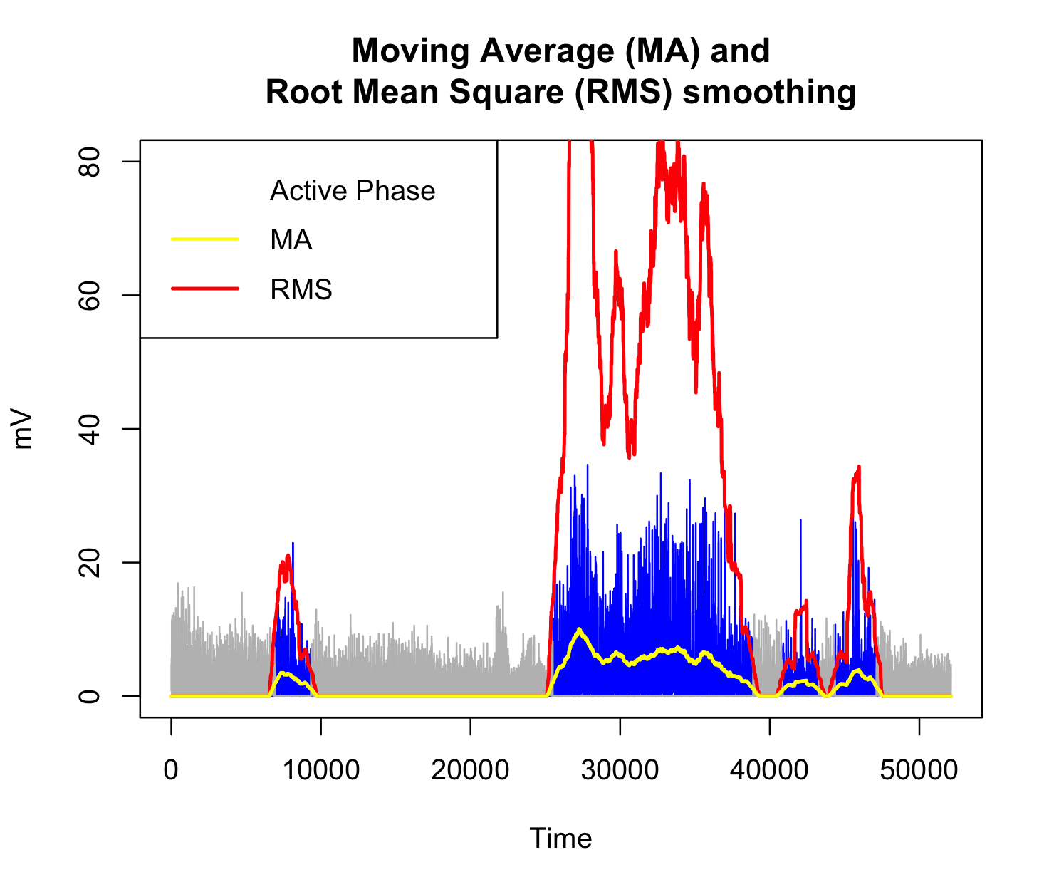
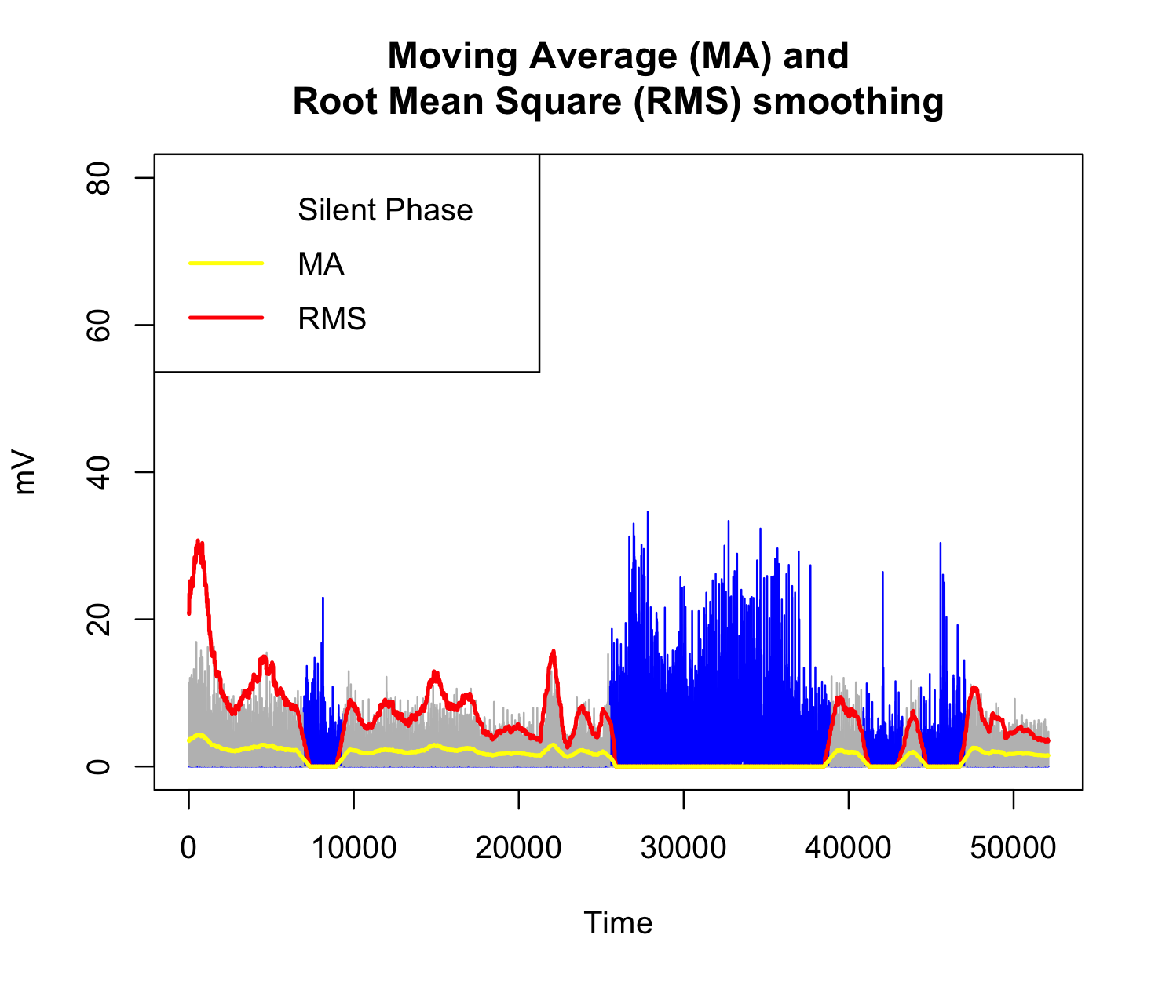
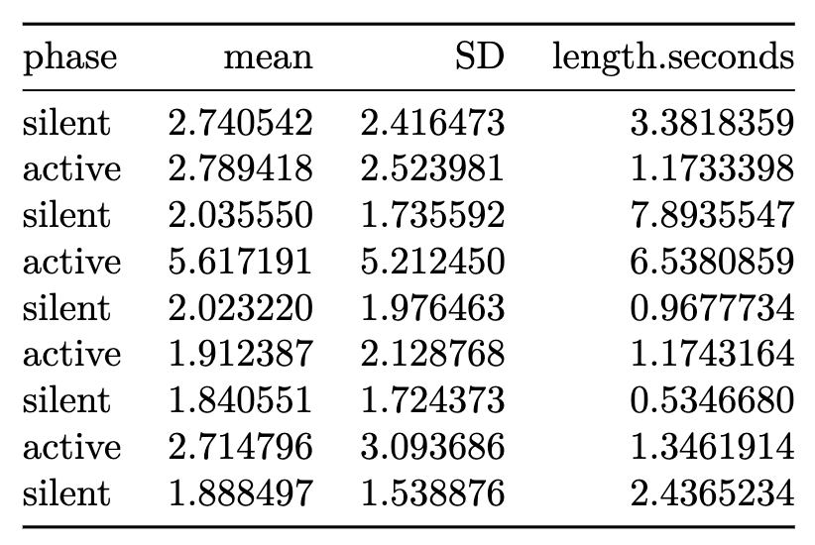
Results
Evaluate results: assess model performance & use On/Off detection for inference
Use of smoothers
Calculating statistics during phases and hypothesis testing between phases
Some nice built-in functions for smoothing envelopes available in biosignalEMG R package
Notes:
The model was useful in that it allowed to use knowledge of On/Off times to further work with the data. By knowing the phase (“active” or ”silent”), we could smooth the data and calculate some statistics based on the individual phases.
After using our algorithm to find the On/Off times, we noted that there are some simple nice tools in the biosignalEMG package for applying smoothing filters and calculating sample stastistics.
These are two methods from the package.

Slide 24
Discussion, Next Steps, Limitations
The authors whose work we relied upon used a GARCH model for post-hoc validation of their method. → We did not do this.
Model assumes normal data, but does not necessarily need to be uncorrelated. → Our data were questionably normal.
Model performance was not objectively measured. This should be done in future work, with more data. → Would require cross-validation with known “true” On-Off times.
Overall, model performed better than expected, considering it was developed and tested by original authors with synthetic data only. → We used real-world, messy data.
Future steps include modifying the algorithm. → Detect phases of data with 3 or more variance terms.
Hyperparameters were not objectively optimized. → Could do this in the future.
Ideally, the method could be used for batch-processing or classifying patterns in a full data set. → Properly designed study with quality-controlled data collection to minimize sources of error.

Slide 25
References
Esquivel-Frausto ME, Guerrero J, Macias-Diaz J (2010). Activity pattern detection in electroneurographic and electromyogram signals through a heteroscedastic change-point method. Mathematical Biosciences, 224, 109-117. https://doi.org/10.1016/j.mbs.2010.01.001
Guerrero J, Macias-Diaz J (2018). _biosignalEMG: Tools for Electromyogram Signals (EMG) Analysis_. R package version 2.1.0, <https://CRAN.R-project.org/package=biosignalEMG>.
Guerrero J, Macias-Diaz J (2014). A computational method for the detection of activation/deactivation patterns in biological signals with three levels of electric intensity. Mathematical Biosciences, 248, 117-127. http://dx.doi.org/10.1016/j.mbs.2013.12.010
Kandel ER, Koester JD, Mack SH, Siegelbaum SA (2021). Principles of Neural Science, 6th Ed. McGraw-Hill.
Stern RM, Ray WJ, Quigley KS (2001). Psychophysiological Recording, 2nd Ed. Oxford University Press.
Werner JM, Berggren J, Kim G, Loffredo K, Pascual M, Tiongson E, Seruya M (2020). Recommendations for therapy following nerve transfer for children with acute flaccid myelitis. Physical & Occupational Therapy In Pediatrics, 41(2), 209-226. https://doi.org/10.1080/01942638.2020.1822981

